Slide 1

Notes:
1
Welcome Message
1

Slide 2
The Rotary Foundation (TRF) – Some Basics
Q. What is The Rotary Foundation (TRF)?
A. It is a Charity.
Q. Who Gives to The Rotary Foundation?
A. Anyone, but mostly Rotarians worldwide.
Who is in charge of deciding how this charity’s
funds are spent?
A. You are. It’s Your Foundation!
Notes:
2
2

Slide 3
The Rotary Foundation
The purpose of The Rotary Foundation of Rotary International is to enable Rotarians to advance world understanding, goodwill, and peace through the improvement of health, the support of education, and the alleviation of poverty.
Notes:
3
3

Slide 4


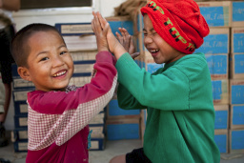
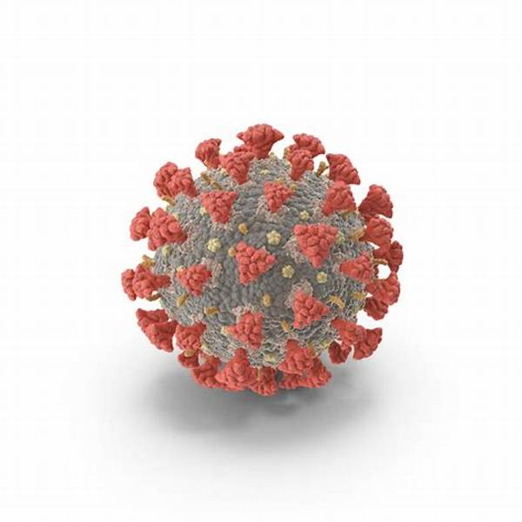

Our Foundation’s Causes
Promoting Peace
Fighting Disease
Providing Clean Water, Sanitation and Hygiene
Saving Mothers and Children
Supporting Education
Growing Local Economies
Disaster Response
Ending Polio Forever
Plus: Supporting the Environment (starting July 1, 2021)
Notes:
4
The six areas of focus reflect critical humanitarian issues and needs being addressed by Rotarians worldwide.
They align Rotary with other international development efforts and advance the Foundation’s mission. Each of the areas listed has specific goals that are outlined in the corresponding area of focus policy statement.
Peace and conflict prevention/resolution
Disease prevention and treatment
Water and sanitation
Maternal and child health
Basic education and literacy
Economic and community development
4

Slide 5
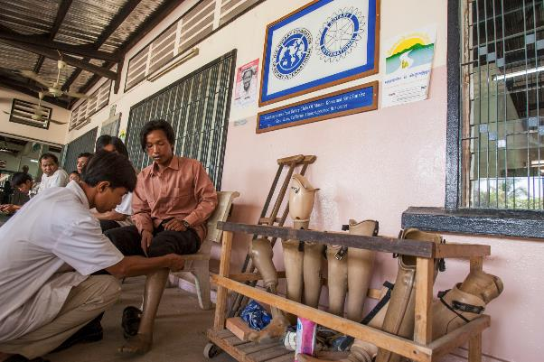
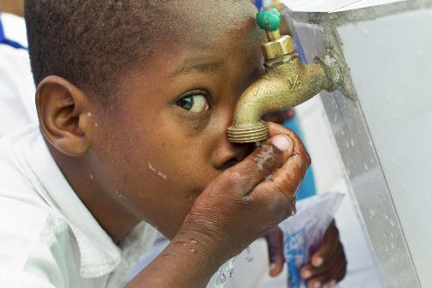
Our Foundation’s Programs
Project Grants
Funding for Club Projects:
Global Grants
District Grants
Scholarships
Vocational Training Teams
Polio Eradication
Rotary Peace Centers
Notes:
5
5

Slide 6
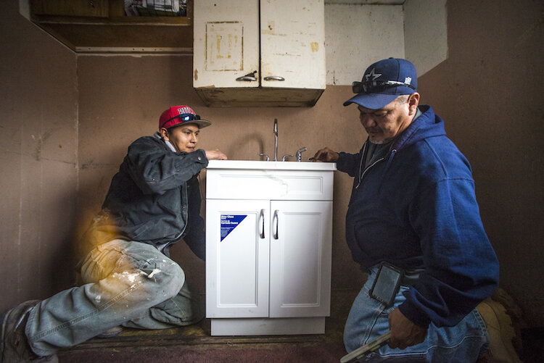
What District 5495 Rotarians are Doing?
    About $2.5 million in Active Global Grants.
    $85,000 in District Grants
    Paid in July 2020 Directly to Clubs
    Navajo Water Project: Phase I/II $795,000
Notes:
6
6

Slide 7





How Can I Get Involved with Global Grants?
    Educate yourself on Global Grants:
      TRF Engagement Day (Nov 2021)
      Grant Management Seminar (Spring 2022)
      Read TRF Guide to Global Grants
      Connect with District Resources and other clubs who
      have completed successful grants.
    Identify a Project and International Partner.
    Identify a Project team.
    Fundraise with other clubs and Districts.
    Apply for a Global Grant (on-line process). 2.8 X Match on Club Contributions.
Notes:
7
7

Slide 8
It’s OUR Foundation
Rotarians Contribute to TRF
Rotarians Spend TRF Funds
Rotarians Develop Projects
Notes:
8
Gifts to the Endowment Fund are held in perpetuity as part of an endowment. They are professionally invested, with a portion of the earnings used each year for purposes specified by the Trustees and the donors.
The Endowment Fund offers donors a way to create their own lasting legacy through Rotary.
8

Slide 9
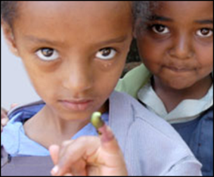
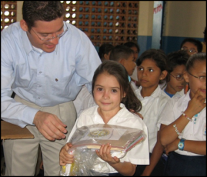
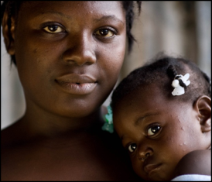
SUPPORTING THE ROTARY FOUNDATION
PolioPlus Fund
End Polio Now
Annual Fund
For Support Today
Endowment Fund
To Secure Tomorrow
Notes:
9
Rotarians support our Foundation through:
The PolioPlus Fund, dedicated to global polio eradication
The Annual Fund, primary source of funding for Foundation grants and activities
The Endowment Fund, which supports the Foundation in perpetuity
9

Slide 10
Rotary Foundation – Why Give?
Top 5 Reasons I Personally Give to The Rotary Foundation
Notes:
10

Slide 11
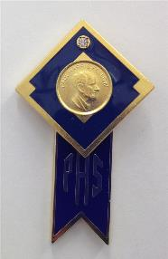

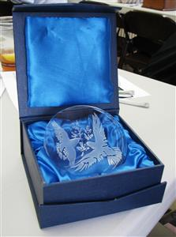

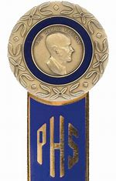



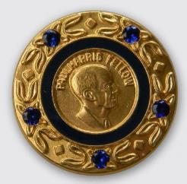
Number 5
The Cool Bling…

Slide 12
Number 4
It’s My Foundation
  It’s Your Foundation
    It’s Our Foundation

Slide 13

Number 3
They Respect my Donations Stewardship
For the 11th consecutive year, The Rotary Foundation has received the highest rating — four stars — from Charity Navigator, an independent evaluator of charities in the U.S.
2019 Score: 100 / 100
Association of Fundraising Professionals named the Rotary Foundation the World’s Outstanding Foundation for 2016
92% of all Donations went directly to Program Awards
Notes:
13

Slide 14

Number 2

Slide 15
And the Number One Reason I Give to The Rotary Foundation….

Slide 16
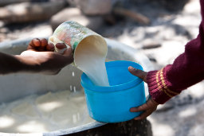
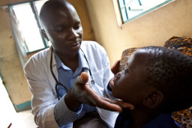
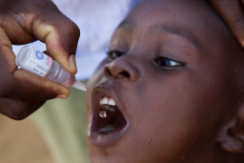
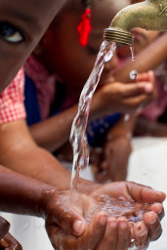
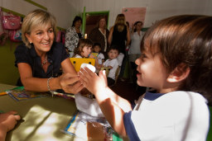

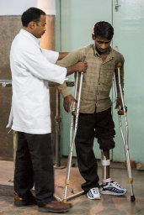
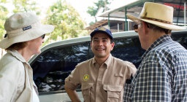


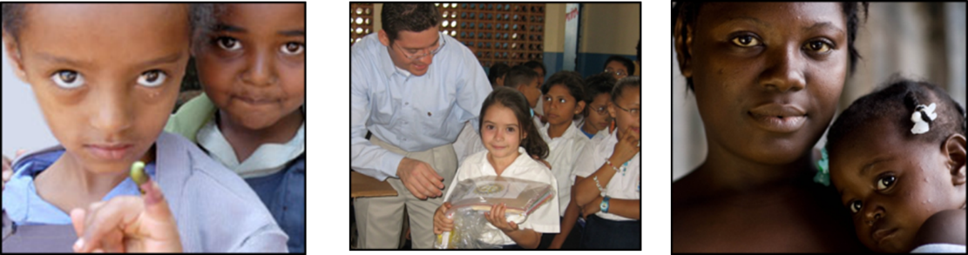
Number 1
Because I can and because they need me…

Slide 17
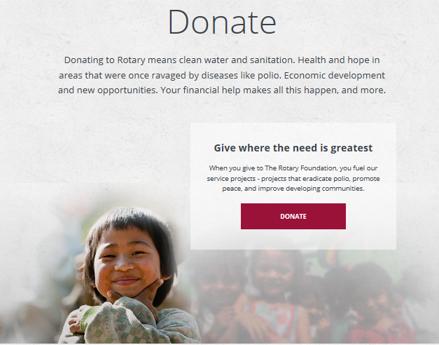

And One More Reason….
Because it’s
Easy…

Slide 18

Some Data…
The majority of all TRF Funding comes from Active Rotarians.
While 80% of Clubs participate in TRF giving, only 32% of all Rotarians give anything (worldwide).
Rotarians that donated $1,000/year represent 30% of all giving but represent less than 10% of Donors (all funds).
Only 1.8% of all Rotarians are Paul Harris Society members but they contributed 18% of all funding (Annual fund).
Only 1.6% of all Rotarians give through Rotary Direct but their average annual giving is $449/yr. 20% of Rotary Direct participants give $1,000 or more/year.

Slide 19

We can Do Better…
We can Do More

Slide 20

Support for
Our Rotary Foundation
There is no question that the clubs which are the most knowledgeable and engaged are also the most generous supporters of The Rotary Foundation. Period.
Notes:
Now that you know why it’s important to support the Annual Fund, here are a few ideas for helping your club have a strong Annual Fund.
1. Set fundraising goals: Clubs that set a goal achieve higher levels of giving than clubs that do not. Consider setting at minimum an Annual Fund and PolioPlus goal.
2. Engage new members: Connect your new members with our Foundation’s good works by sharing videos, images, and statistics that show the Foundation at work. Ask new members to participate in a Foundation-funded project or invite them to support the Foundation through Rotary Direct, the Foundation’s recurring giving program.
3. Hold an area of focus fundraiser: Let your community know about the great work of Rotary by holding a fundraiser for one of our six areas of focus. This is a great opportunity to give an update about a project that your district or club is doing in one of the six areas of focus. For fundraising ideas, visit the Fundraising page in the Learning & Reference section of My Rotary.
Go to the Learning & Reference drop-down menu, choose Learn by Topic, then Fundraising.
4. Recognize club members: Set aside time to thank club members for their contributions. A thank-you card can show appreciation and lead to continued support.
Ask: What other methods for generating support have been successful in your club?
20

Slide 21
Rotary Direct
Regular and automatic giving to
The Rotary Foundation
You already subscribe to Netflix and Prime…
Why not subscribe to Humanity with Rotary Direct?
Set up regular giving on the Rotary website
– it’s EASY!
Notes:
How do you find accurate information to thank your members for their contributions?
Club officers can run Foundation reports on Rotary.org to find information:
Club Recognition Summary: Includes members’ Paul Harris Fellow status, recognition amount, available Foundation recognition points, Rotary Direct participation, and most recent contribution date and designation. The report also indicates 100% Paul Harris Fellow Club achievement and date, along with clubs’ all-time Foundation giving. The report can also be used to identify noncontributing clubs.
Paul Harris Society Report: Includes members’ Paul Harris Society status and a four-year history of eligibility, as well as a tab with donor contact information.
Club Foundation Banner Report: Includes eligibility dates achieved for the recognition Every Rotarian, Every Year, along with Rotary Foundation giving.
SHARE Contribution Detail Report: Shows each club’s Annual Fund-SHARE contributions and the District Designated Funds that will result in three years. Club officers, such as the Foundation chair, have access on My Rotary to this report.
Benefactor Report: Includes a list of Paul Harris Fellows and Benefactors of The Rotary Foundation, with achieved date, donor ID, and Rotary club.
Major Donor, Arch Klumph Society, and Bequest Society Report: Includes lists of Major Donors, Bequest Society members, and Arch Klumph Society members, with their recognition dates. The report also has two tabs with mailing address information.
21

Slide 22
Every Rotarian Every Year
Giving Goal for the past 20 years: $100/yr
D5495 Goal for 2021-22: $156/year – Every Rotarian
$39/quarter (Regular Giving thru Rotary Direct)
$13/month (Regular Giving thru Rotary Direct)
That is only $3 per week! Less that the price of a Latte.
Notes:
How do you find accurate information to thank your members for their contributions?
Club officers can run Foundation reports on Rotary.org to find information:
Club Recognition Summary: Includes members’ Paul Harris Fellow status, recognition amount, available Foundation recognition points, Rotary Direct participation, and most recent contribution date and designation. The report also indicates 100% Paul Harris Fellow Club achievement and date, along with clubs’ all-time Foundation giving. The report can also be used to identify noncontributing clubs.
Paul Harris Society Report: Includes members’ Paul Harris Society status and a four-year history of eligibility, as well as a tab with donor contact information.
Club Foundation Banner Report: Includes eligibility dates achieved for the recognition Every Rotarian, Every Year, along with Rotary Foundation giving.
SHARE Contribution Detail Report: Shows each club’s Annual Fund-SHARE contributions and the District Designated Funds that will result in three years. Club officers, such as the Foundation chair, have access on My Rotary to this report.
Benefactor Report: Includes a list of Paul Harris Fellows and Benefactors of The Rotary Foundation, with achieved date, donor ID, and Rotary club.
Major Donor, Arch Klumph Society, and Bequest Society Report: Includes lists of Major Donors, Bequest Society members, and Arch Klumph Society members, with their recognition dates. The report also has two tabs with mailing address information.
22

Slide 23
Have a Rotary Direct Club Meeting
Instead of a Speaker – Walk everyone through singing up for Rotary Direct on their Phones.
Make sure you stop billing members for TRF contributions if they sign up for Rotary Direct.

Slide 24
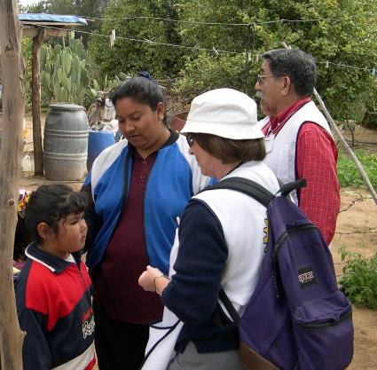
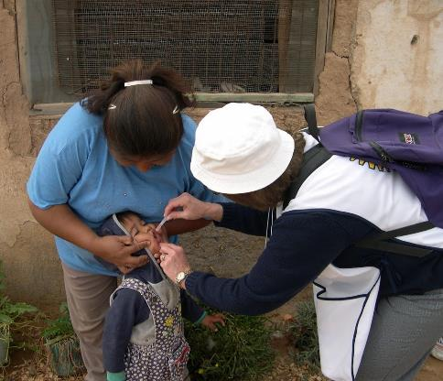

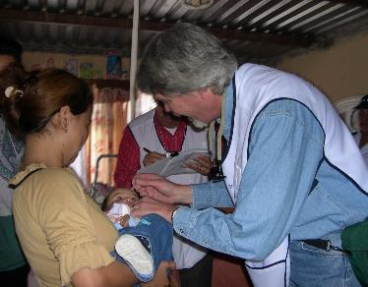
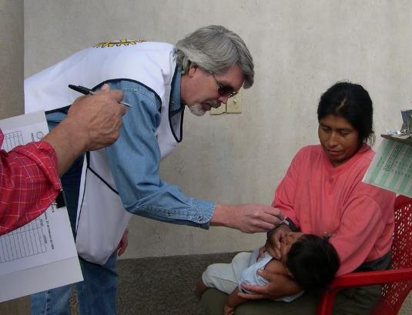
END POLIO NOW
FULFILLING OUR PROMISE
Notes:
24
Rotary’s own financial support for PolioPlus will be magnified by an agreement with the Bill & Melinda Gates Foundation.
From 2013 to 2018, every $1 that Rotary commits in direct support of polio immunization (up to $35 million per year) will be matched by an additional $2 from the Gates Foundation. This means contributions to Rotary’s PolioPlus program will have three times the impact.
24

Slide 25
What is Polio?
Poliomyelitis is a highly infectious disease that most commonly affects children under the age of 5.
The first documented case of Polio: 1580 BC. It has inflicted more human beings than almost any other disease.
The virus is spread person to person, typically through contaminated water.
It can attack the nervous system, and in some instances, lead to paralysis.
There is no cure.
There is a safe and effective vaccine since 1955.

Slide 26
Some Perspective…
Rotary’s Long History with Polio Eradication:
1n 1985 Rotary launched Polio Plus: The largest ever global initiative to fight a disease.
In 1985 Polio infected 1,000 children Per Day in dozens of Endemic Countries. Since Then:
  Billions of children have been immunized.
  20 million volunteers have worked to immunize children.
  Billions of dollars have been spent in 200 countries.
  Millions of lives have been saved.

Slide 27





Our Partners
Nations Around
The World

Slide 28
Where Are We Now?
India is Polio Free
The African Continent is Polio Free
Only two endemic countries left: Pakistan & Afghanistan
Today’s Data:
114 - The number of days since the last case of the wild poliovirus occurred in in the world.
2 - The total number of cases of the wild poliovirus that occurred in the world since New Years Day 2021.
54 - The number of cases of the wild poliovirus that occurred in 2020 on this date.
Hold your breath and cross your fingers …. No more new cases in 2021

Slide 29

COVID-19 and Polio Eradication
Transferring our Knowledge to Fight COVID-19
Polio eradication staff support COVID-19 response:
Medical staff are working flat out to mitigate further spread, using lessons learned from their years battling the poliovirus.
The world is utilizing the vast infrastructure developed to identify the poliovirus and deliver vaccination campaigns – to fight SARS-COV-2 (Corona Virus)
From Pakistan to Nigeria, the program is drawing on years of experience fighting outbreaks to support governments as they respond to the new virus.
  Surveillance
  Contact Tracing
  Vaccine Distribution (when ready)
The WHO Regional Office for Africa’s Rapid Response Team, who usually respond to polio outbreaks, are aiding COVID-19 response in countries including Angola, Cameroon and the Central African Republic.

Slide 30

What Can We Do?
Educate yourself about this disease:
www.polioeradication.org
Spread the Word: We are on the verge of making history!

Slide 31


Bill and Melinda Gates Foundation
Match Extended 3 Years
Rotary is committed to raising $50 million per year over the next three years, with every dollar to be matched with two additional dollars from the Gates Foundation.
This expanded agreement will translate into up to $450 million for polio eradication activities.
We Need to Continue to Fundraise for Polio – Now more than Ever
  Every Dollar Raised is $3 (with match)
  $3 protects one child from Polio

Slide 32

Polio Plus Society
Become a Member of the Polio Plus Society – NEW!
Commit to donating $100 every year until Polio is eradicated.
Receive a Certificate and Polio Plus Society Pin.
All donations matched 2:1 by Bill and Melinda Gates Foundation
It’s easy to donate through Rotary Direct.
More Info on the District Website
Notes:
32
32

Slide 33
Resources
District Website
    Lots of links to specific resources – get quick answers to your questions
Rotary Learning Center
    Educational resources for you and your club
District TRF Committee Members
Always available to assist
Notes:
33
Review Take Action items, add your own, and ask participants for any additional items.
33

Slide 34
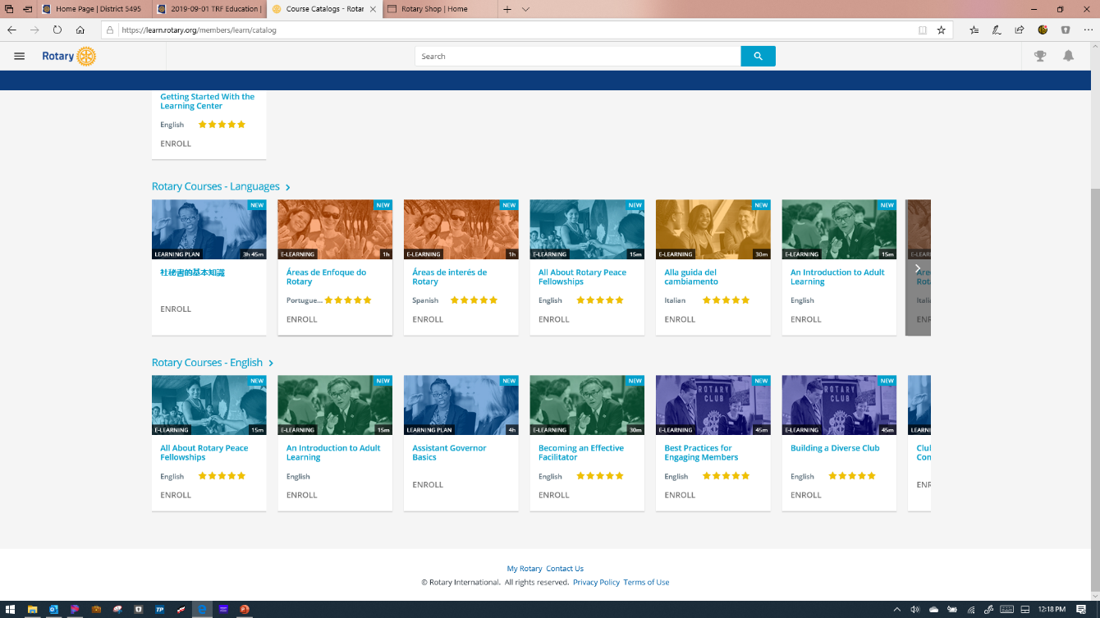
ROTARY LEARNING CENTER

Slide 35

Questions?
Notes:
35
Welcome Message
35

Slide 36
Notes:
36
Welcome Message
36

