Slide 1

Grants Management
Seminar
Notes:
1
1

Slide 2
The Rotary Foundation (TRF) – Some Basics
Q. What is The Rotary Foundation (TRF)?
A. It is a Charity.
Q. Who Gives to The Rotary Foundation?
A. Anyone, but mostly Rotarians worldwide.
Who is in charge of deciding how this charity’s
funds are spent?
A. You are. It’s Your Foundation!
Notes:
2
2

Slide 3
The Rotary Foundation Mission
The mission of The Rotary Foundation of Rotary International is to enable Rotarians to advance world understanding, goodwill, and peace through the improvement of health, the support of education, and the alleviation of poverty.
Notes:
3
3

Slide 4


7 AREAS OF FOCUS
Peace and Conflict Resolution
Disease Prevention and Treatment
Water, Sanitation and Hygiene
Maternal and Child Health
Basic Education and Literacy
Economic and Community Development
Supporting the Environment
Notes:
4
The six areas of focus reflect critical humanitarian issues and needs being addressed by Rotarians worldwide.
They align Rotary with other international development efforts and advance the Foundation’s mission. Each of the areas listed has specific goals that are outlined in the corresponding area of focus policy statement.
Peace and conflict prevention/resolution
Disease prevention and treatment
Water and sanitation
Maternal and child health
Basic education and literacy
Economic and community development
4

Slide 5
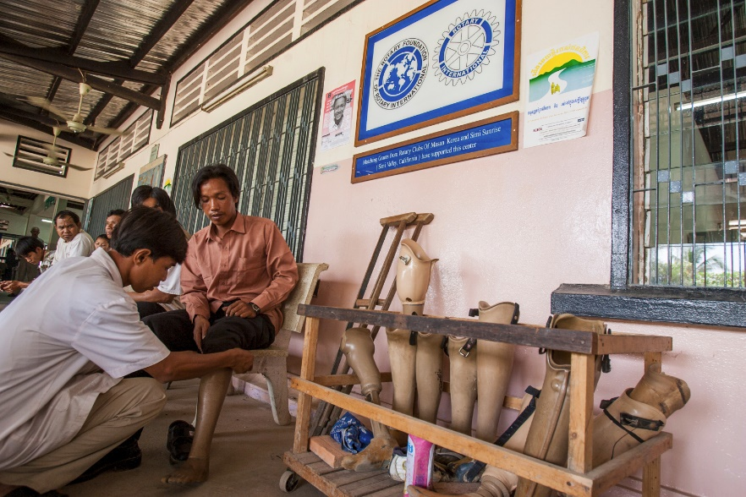

Rotary Foundation – Programs
Project Grants
Funding for Club Projects:
Global Grants
District Grants
Scholarships
Vocational Training Teams
Polio Eradication
Rotary Peace Centers
Notes:
5
5

Slide 6
Types of GRANTS
District Grants
Administered by the District Foundation Committee
Global Grants
Administered by The Rotary Foundation Staff
Notes:
6
District grants are single, annual block grants made to districts in amounts up to 50 percent of their District Designated Fund (DDF).
The district grant can fund multiple club and district projects, which may be local or international.
District grants allow local decision making, with minimal restrictions, for smaller-scale activities and projects.
6

Slide 7
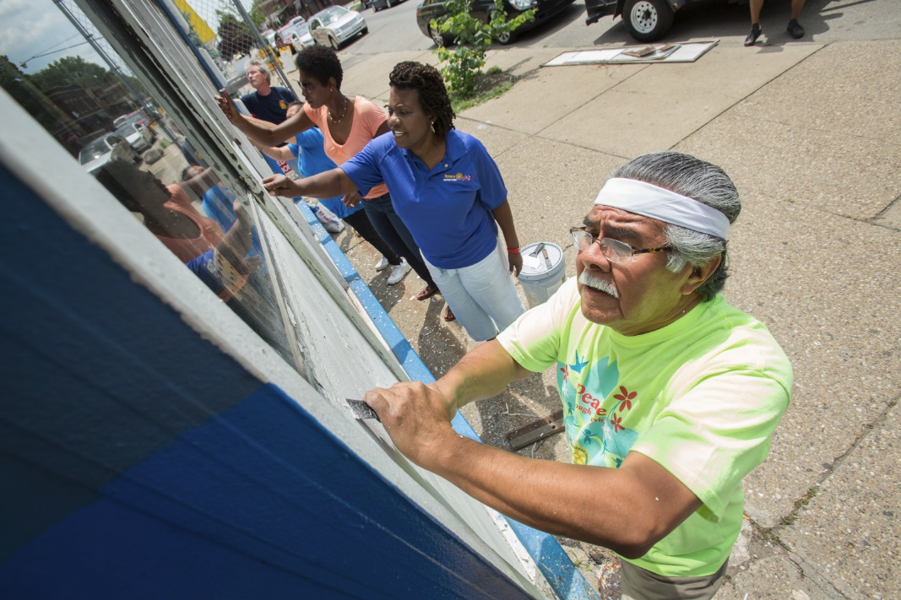
FEATURES OF A DISTRICT GRANT
A single block grant from TRF, awarded annually to the District for club and district projects.
  TRF Funds distributed by the District (guidelines vary by District)
  Local or international activities
  Local decision making with flexible guidelines
  Smaller, shorter term activities and projects
Notes:
7
District grants are single, annual block grants made to districts in amounts up to 50 percent of their District Designated Fund (DDF).
The district grant can fund multiple club and district projects, which may be local or international.
District grants allow local decision making, with minimal restrictions, for smaller-scale activities and projects.
7

Slide 8


DISTRICT GRANT ACTIVITIES
Must include active Rotarian participation
Adhere to stewardship guidelines
Clubs Apply through the District
Must Align with the Foundation’s
mission
Notes:
8
Activities funded by district grants must:
Include active Rotarian participation
Adhere to stewardship guidelines
Demonstrate cultural sensitivity
Be consistent with the mission of The Rotary Foundation (but they need not be related to an area of focus)
ASK: What types of projects or activities do you think are possible when using The Rotary Foundation mission as a guide?
8

Slide 9
FEATURES OF A GLOBAL GRANT
Requires a partner club in another country
Aligns with one of the six Areas of Focus
Includes active community and Rotarian participation
Has long-term, sustainable benefits
Has measurable results
Has a total budget of at least $30,000 (includes matching contributions from District and World Fund)
Notes:
9
Global grants fund large-scale projects and activities that:
Align with an area of focus
Respond to a need the benefiting community has identified
Include the active participation of the benefiting community
Include the active participation of Rotarians
Strengthen local knowledge, skills, and resources
Are designed to enable the benefiting community to address its own needs after the Rotary club or district has concluded its work
Have measurable results
The minimum grant award is $15,000 (for a total budget of at least $30,000). The DDF allocation is matched 100 percent, and cash is matched at 50 percent from the World Fund. A global grant project is sponsored by a host club in the project country and a club outside the project country.
9

Slide 10
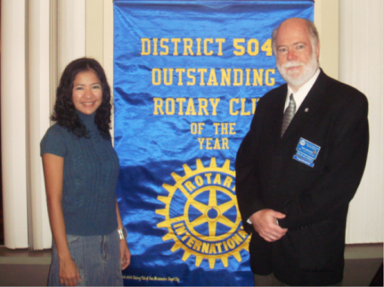
SCHOLARSHIPS
Scholarships can be funded by:
Global Grants
Larger $$ but have specific requirements
District Grants
Smaller $$ but more flexible
Notes:
10
Under the new grant model, Rotary continues promoting peace through education.
Clubs and districts have more flexibility in sponsoring international and local scholars through global grants and district grants.
10

Slide 11
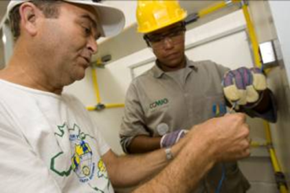
VOCATIONAL TRAINING TEAMS
Traveling Teams of Professionals:
  Learn about their vocation Or Teach other professionals about their vocation.
  Can be funded through either by District or Global Grants (requirements differ).
Notes:
11
Vocational training teams are groups of professionals who travel, either to learn more about their vocation or to teach local professionals about a particular field. These teams can expand the knowledge and skills of individuals and communities.
The vocational training team concept was inspired by the successes of past grant programs, including Group Study Exchange and Volunteer Service Grants.
Rotary clubs and districts can support vocational training teams through district grants or global grants.
11

Slide 12
How are Grants Funded?
Grant Funding =
  Club $
  Individual $
  Rotary Foundation (TRF) $
Grants are provided as a conditional “match” to cash contributions.
Notes:
Other than Polio Funds, all the funds from the Annual Fund or all the earnings from the Endowment Fund are funds that are given back to clubs to help finance projects. These funds are given back, however, as a “conditional match.” Which means that a club must also but money into a project.

Slide 13
Two sources of
TRF $ for Grants
District Designated Fund (DDF) Controlled and distributed by D5495 Foundation Committee
World Fund
Controlled and distributed by TRF Trustees
Notes:
The Rotary Foundation provides money in two forms:
District Designated Funds, or DDF,
And also money directly from The Rotary Foundation… which is called the World Fund

Slide 14
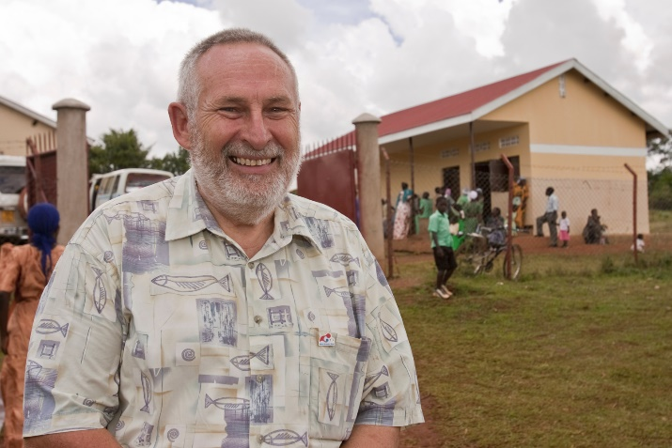
Grant Funding and “Share”
Local and international GRANTS are funded through the SHARE system:
District Designated Fund (DDF)
World Fund
SHARE
Grant Funding
Notes:
14
Contributions to the Annual Fund support local and international grants and activities through the SHARE system.
Contributions are credited to the individual donor and the donor’s club and counted toward the club’s and district’s Annual Fund goals.
14

Slide 15


SHARE SYSTEM
Donations + Earnings
$$$
Donations
$
3 Year
Investment Period
Investment operating expenses offset by earnings
Notes:
What is the SHARE system?
Contributions from Rotarians and friends of Rotary fund Rotary Foundation grants and programs.
Only when donors designate Annual Fund-SHARE for their gifts do they enter the SHARE system.
Donors designating their gifts for Endowment Fund-SHARE have their spendable earnings enter the SHARE system.
Gifts to the PolioPlus Fund do not enter the SHARE system.
15

Slide 16
SHARE SYSTEM
Annual Fund SHARE Donations
After 3 Year Investment Period
50%
50%
Distributions
By Districts
District Designated Fund (DDF)
World Fund
Distributions
by Trustees
SHARE
Donations*
District Grants
(Up to 50%)
Matching funds for Global Grants
Other Grants and Programs*
* PolioPlus, Peace Centers,
Other Districts, etc.
Notes:
The SHARE system divides the funds between the World Fund and District Designated Fund (DDF).
District Designated Funds are used for Rotary grants and activities that do good in the world. The Trustees decide how the World Fund is spent.
Each district’s Rotary Foundation committee decides how its DDF is spent.
16

Slide 17
How Can My Club Qualify for Grants?
1. TRAINING
2. ACCEPTANCE of SEWARDSHIP
3. GIVING

Slide 18
Requirement One: TRAINING
Two club members must attend
Grant Management Seminar
Recommended:
Club President Elect
Club Rotary Foundation Chair

Slide 19
Requirement Two: STEWARDSHIP
Stewardship is the responsible management and oversight of grant funds, including:
  Standard business practices
  Rotarian supervision
  Financial records review
  Oversight of funds
  Reporting of irregularities
  Timely submission of reports
Notes:
Explain that stewardship is part of Rotary’s core values of service and integrity, reflected in The Four-Way Test and the Declaration of Rotarians in Businesses and Professions. Emphasize that clubs must follow standard business practices for managing these funds.
Outline how having Rotarians supervise the project protects the interests of The Rotary Foundation.
Highlight the importance of reviewing financial records to confirm proper use of funds. Stress that good stewardship is achieved by putting systems in place that create clubwide awareness of the use of funds. Widespread knowledge helps prevent mismanagement.
Explain that stewardship is the responsible fiscal management and oversight of grant funds.
Any irregularities or misuse of grant funds should be reported immediately.
Highlight the importance of submitting timely, complete, and accurate reports, which documents the club’s good stewardship of funds to all donors of The Rotary Foundation.
Explain the relationship between the club’s level of oversight, transparency, and accountability for managing Foundation grant funds and the impact of donors’ confidence in giving to our Foundation.
Charlie

Slide 20
Acceptance of Stewardship:
A signed Memorandum of Understanding (M.O.U.)
Club Qualification
Club Officer Responsibilities
Financial Management Plan
Bank Account Requirements
Report on Use of Grant Funds
Document Retention
Report of Misuse of Grant Funds
District 5495 Addendum
Required by
Rotary International

Slide 21
MOU – Club Qualification
Upon successful completion of the qualification requirements, the club will be qualified for one Rotary year.
The club must comply with MOU, additional district requirements, and all applicable TRF policies.
The club is responsible for the use of funds for club-sponsored grants, regardless of who controls the funds.
Qualification may be suspended or revoked for misuse or mismanagement of grant funds.
The club must cooperate with any financial, grant, or operational audits.

Slide 22
MOU – Club Officer Responsibilities
The club officers hold primary responsibility for club qualification and the proper implementation of TRF grants.
Club officer responsibilities include:
Appointing at least one club member to implement, manage, and maintain club qualification.
Ensuring that all TRF grants adhere to stewardship measures and proper grant management practices.
Ensuring that all individuals involved in a grant conduct their activities in a way that avoids any actual or perceived conflict of interest.

Slide 23
Conflict of Interest
Any potential conflict of interest must be reported to TRF and District Foundation Committee.
Potential Conflicts of Interest:
Exists when a Rotarian benefits financially or personally from a grant.
Benefit can be direct (the Rotarian benefits) or indirect (an associate of the Rotarian benefits).
Notes:
Key points
A conflict of interest exists when a Rotarian may benefit financially or personally from grant activities.
The benefit can be either direct (the Rotarian benefits) or indirect (an associate of the Rotarian benefits).
Financial benefits could include receiving grant funds for being a project manager or receiving grant funds as a vendor for the project.
Personal benefits could include receiving a promotion, getting business referrals, or gaining publicity or improved social standing.
Associates can include family members, friends, Rotarians, personal acquaintances, colleagues, and business partners.
What are some examples of conflict of interest?
Sample responses
A Rotarian on the grant project committee is a paid staff member of an organization benefiting from a grant.
A Rotarian’s niece is invited to participate on a vocational training team and selected over a participant with more experience.
A Rotarian lives in a community that is receiving a village water well.
Why should clubs be concerned about conflicts of interest?
Sample responses
A public perception that local Rotarians are acting in their own interest can ruin their credibility in the community.
Grant project may be less likely to meet beneficiaries’ needs.
If donors believe Rotarians are using funds to benefit themselves, instead of the intended community, they may decide not to donate in the future.
Key points
Rotarians have a reputation for professional integrity. Addressing and preventing conflict of interest helps preserve this reputation for the club, district, and The Rotary Foundation.
When Rotarians freely disclose any direct or indirect association with the grant project, they help ensure fair process and transparency in the use of Foundation funds.
Rotarians must disclose any conflicts of interest on the grant application. If Rotarians aren’t sure whether a particular situation is a conflict of interest, they should talk with their grant coordinator.
George

Slide 24
MOU – Financial Management Plan
The club must have a written* financial management plan to provide consistent administration of grant funds.
The financial management plan must include procedures to
Maintain a standard set of accounts, which includes a complete record of all receipts and disbursements of grant funds.
Disburse grant funds, as appropriate.
Maintain segregation of duties for handling funds.
Establish an inventory system for equipment and other assets purchased with grant funds, and maintain records for items that are purchased, produced, or distributed through grant activities.
Ensure that all grant activities, including the conversion of funds, comply with local law.
* A template club financial management plan is available form the District.

Slide 25
MOU – Bank Account Requirements
In order to receive Global Grant funds, the club must have a dedicated bank account* that is used solely for receiving and disbursing TRF grant funds.
The club bank account must:
  Have a minimum of two Rotarian signatories.
  Be a low- or noninterest-bearing account
  Interest earned must be documented and used for eligible expenses.
  A separate account should be opened for each club-sponsored grant.
  Grant funds may not be deposited in investment accounts.
  Bank statements must be made available.
  The club must maintain a written plan for transferring custody of the bank accounts in the event of a change in signatories.

Slide 26
MOU – Report on Use of Grant Funds
The club must adhere to all TRF reporting requirements.
  Grant reporting is a key aspect of grant management and stewardship.
  Reports inform TRF of the grant’s progress and how funds are spent.

Slide 27
MOU – Document Retention
The club must establish and maintain appropriate recordkeeping systems to preserve important documents and support transparency.
A. Documents that must be maintained include, but are not limited to:
Bank information, including copies of past statements
Club qualification documents including a copy of the signed club MOU
Documented plans and procedures, including:
    Financial management plan
    Procedure for storing documents and archives
    Succession plan for bank account signatories and retention of information and documentation
    Information related to grants, including receipts and invoices for all purchases
Club records must be accessible and available the club and district.
Documents must be maintained for a minimum of five years.

Slide 28
MOU –Reporting Misuse of Grant Funds
The club must report any potential and real misuse or mismanagement of grant funds to the district.
This reporting fosters an environment in the club that does not tolerate the misuse of grant funds.

Slide 29
District Addendum to M.O.U.
  Appoint a Club Rotary Foundation Chair to a 3-year term.
  Have at least two members attend the District Foundation Grants Seminar annually.
  Be current on its RI and District dues, and in good standing with the District, Rotary International, and The Rotary Foundation.
  Be current on all required tax returns for the Rotary Club and any associated Club Foundation.
  Have established and reported an annual giving goal to the District Foundation Chair for the current year and for the next year (Rotary Club Central).
  Have contributed to the Rotary Foundation Annual Giving Fund in the previous year or the current year.
  Have, by January 1st of each year, reported its Club President-Elect to the District and to Rotary International.
  Be current on all Rotary Foundation Grant reports.

Slide 30
Important ”Must Reads”
“Grants Terms and Conditions”
“District Grant Guidelines”
“Guide to Global Grants”
“MOU and District Addendum”
All on the District 5495 website

Slide 31
Session 2
District Grants

Slide 32


DISTRICT GRANTS

Slide 33
FEATURES OF A DISTRICT GRANT
A single block grant from TRF, awarded annually to the District for club and district projects.
  TRF Funds distributed by the District (guidelines vary by District)
  Local or international activities
  Local decision making with flexible guidelines
  Smaller, shorter term activities and projects
Notes:
33
District grants are single, annual block grants made to districts in amounts up to 50 percent of their District Designated Fund (DDF).
The district grant can fund multiple club and district projects, which may be local or international.
District grants allow local decision making, with minimal restrictions, for smaller-scale activities and projects.
33

Slide 34
DISTRICT GRANT ACTIVITIES
Must include active Rotarian participation
Adhere to stewardship guidelines
Clubs Apply through the District
Must Align with the Foundation’s
mission
Notes:
34
Activities funded by district grants must:
Include active Rotarian participation
Adhere to stewardship guidelines
Demonstrate cultural sensitivity
Be consistent with the mission of The Rotary Foundation (but they need not be related to an area of focus)
ASK: What types of projects or activities do you think are possible when using The Rotary Foundation mission as a guide?
34

Slide 35

The Mission of TRF
To enable Rotarians to advance world understanding, goodwill, and peace through the improvement of health, the support of education, and the alleviation of poverty.
Notes:
35
Activities funded by district grants must:
Include active Rotarian participation
Adhere to stewardship guidelines
Demonstrate cultural sensitivity
Be consistent with the mission of The Rotary Foundation (but they need not be related to an area of focus)
ASK: What types of projects or activities do you think are possible when using The Rotary Foundation mission as a guide?
35

Slide 36
DISTRICT GRANTS; Design and Planning
Everything you need to know..
…is in 2023-24 District Grants Guidelines (Download from rotary5495.org)

Slide 37
DISTRICT GRANTS; Design and Planning
Financial
District will match Club funds 2:1
Maximum DDF awarded for single club request is $2500

Slide 38
DISTRICT GRANTS; Design and Planning
Financial
District will match Club funds 2:1
To obtain the maximum match, the minimum club contribution is $1250

Slide 39
DISTRICT GRANTS; Design and Planning
Two-Tiered District match based on giving
  $1000 Maximum for clubs which have given something in 2021-22 or 2022-23
  $2500 Maximum for clubs which have given $100 or more per capita (average giving).

Slide 40
DISTRICT GRANTS; Application
Rotarygrants.org
Step-by-step instructions are in the Guidelines document

Slide 41
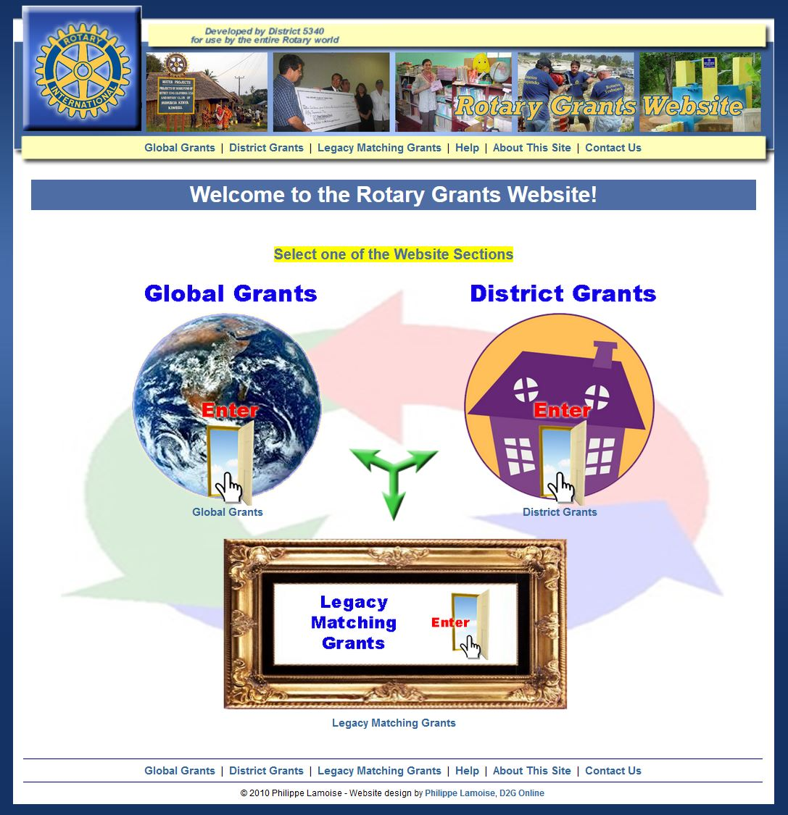

Slide 42
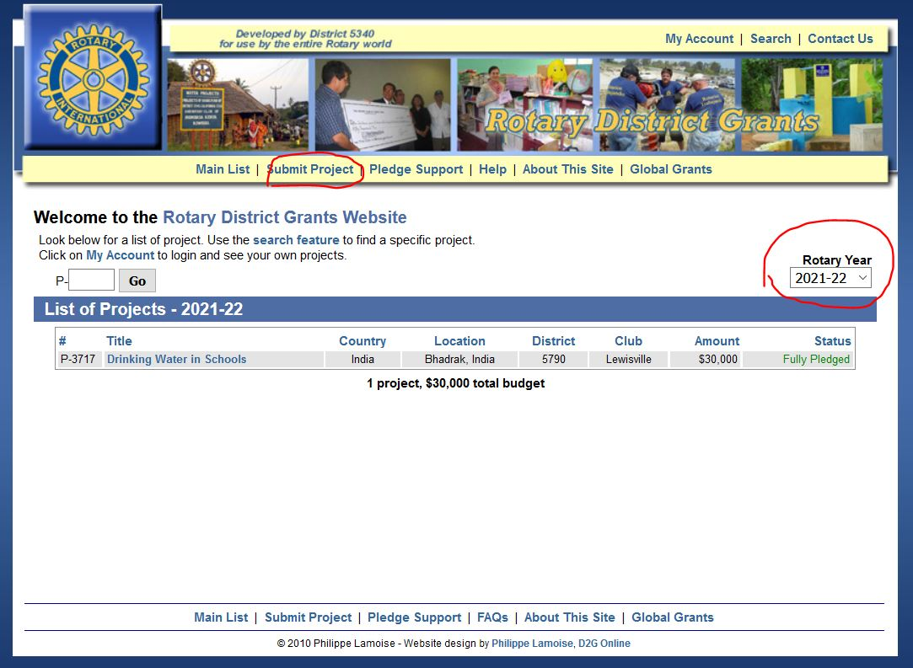

Slide 43
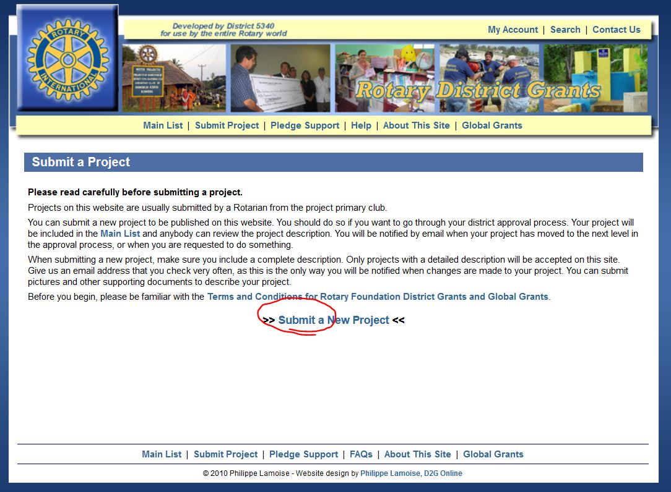

Slide 44
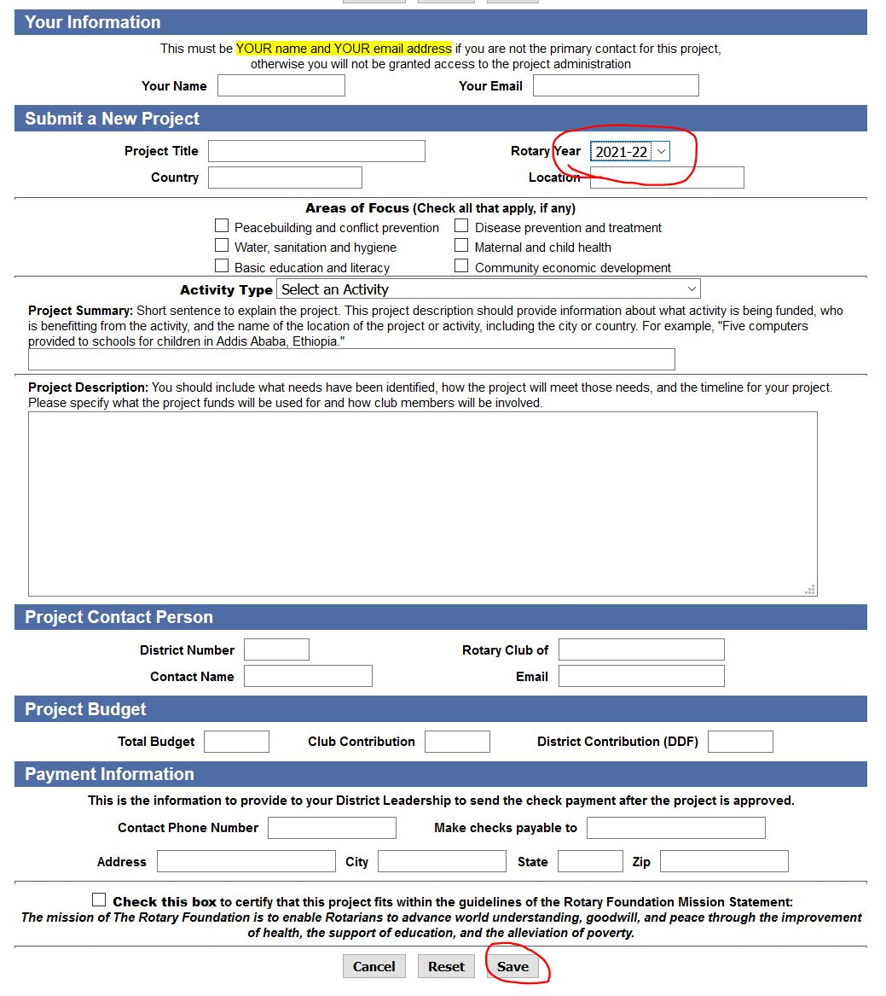

Slide 45
DISTRICT GRANTS; Application
Project Description:
List the Rotary Clubs involved in the project if it is a joint club project.
Include a concise description of the project objectives including how the project will benefit the community and/or improve lives.
Describe specific Rotarian activities.
Describe how the public will know this is a Rotary-Sponsored project.
If the project involves a cooperating organization, provide the name(s) of the organization(s).

Slide 46
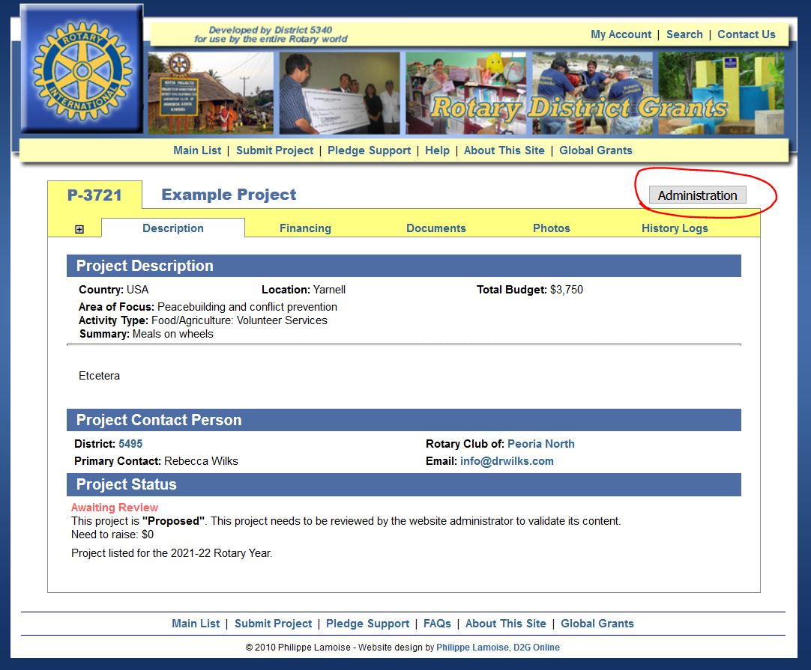

Slide 47
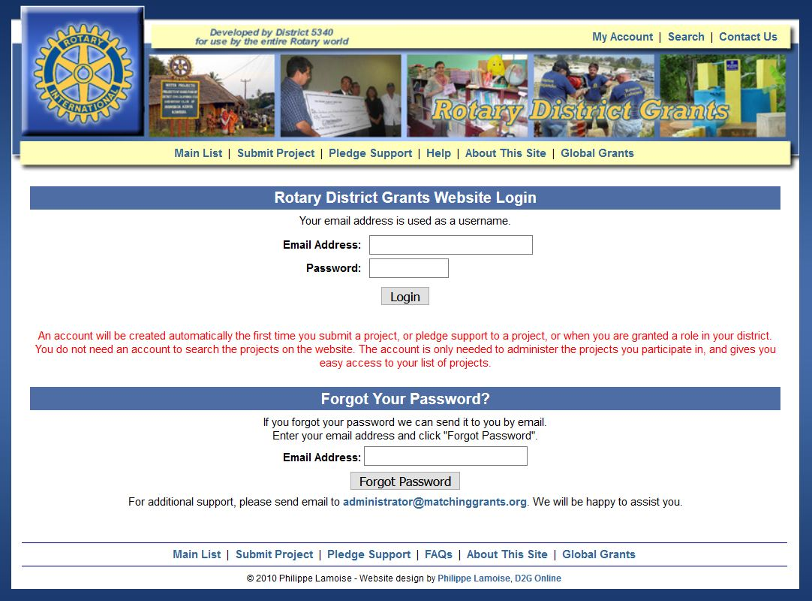

Slide 48
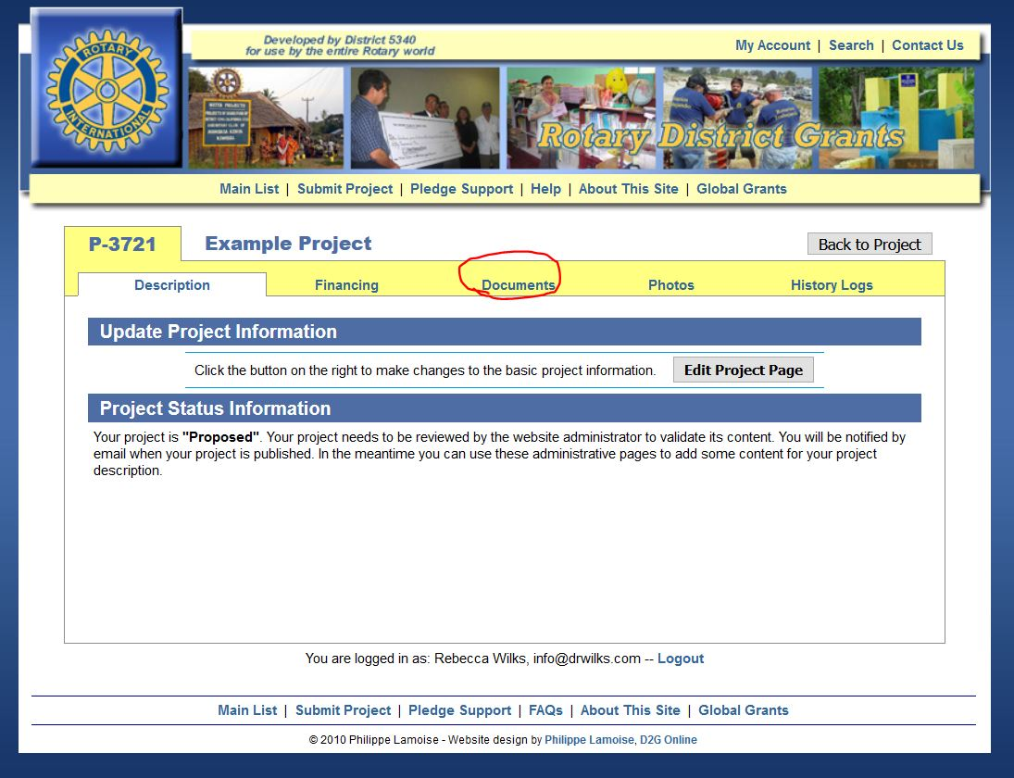

Slide 49
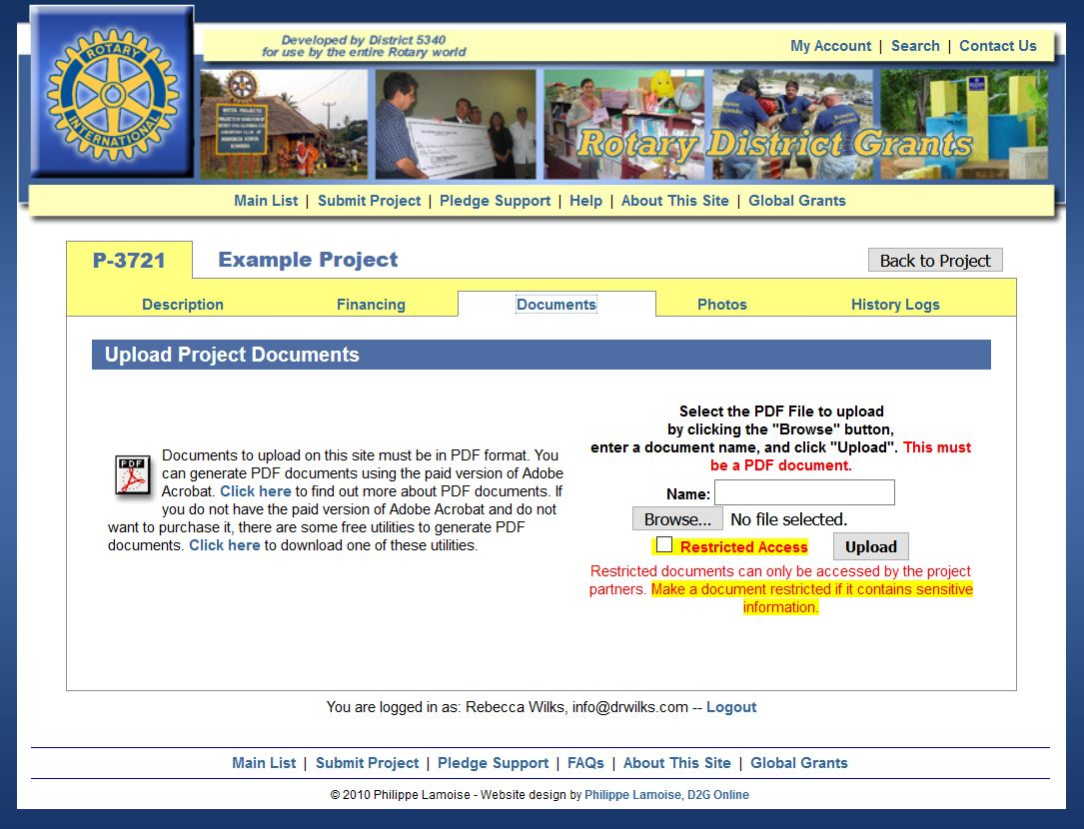

Slide 50
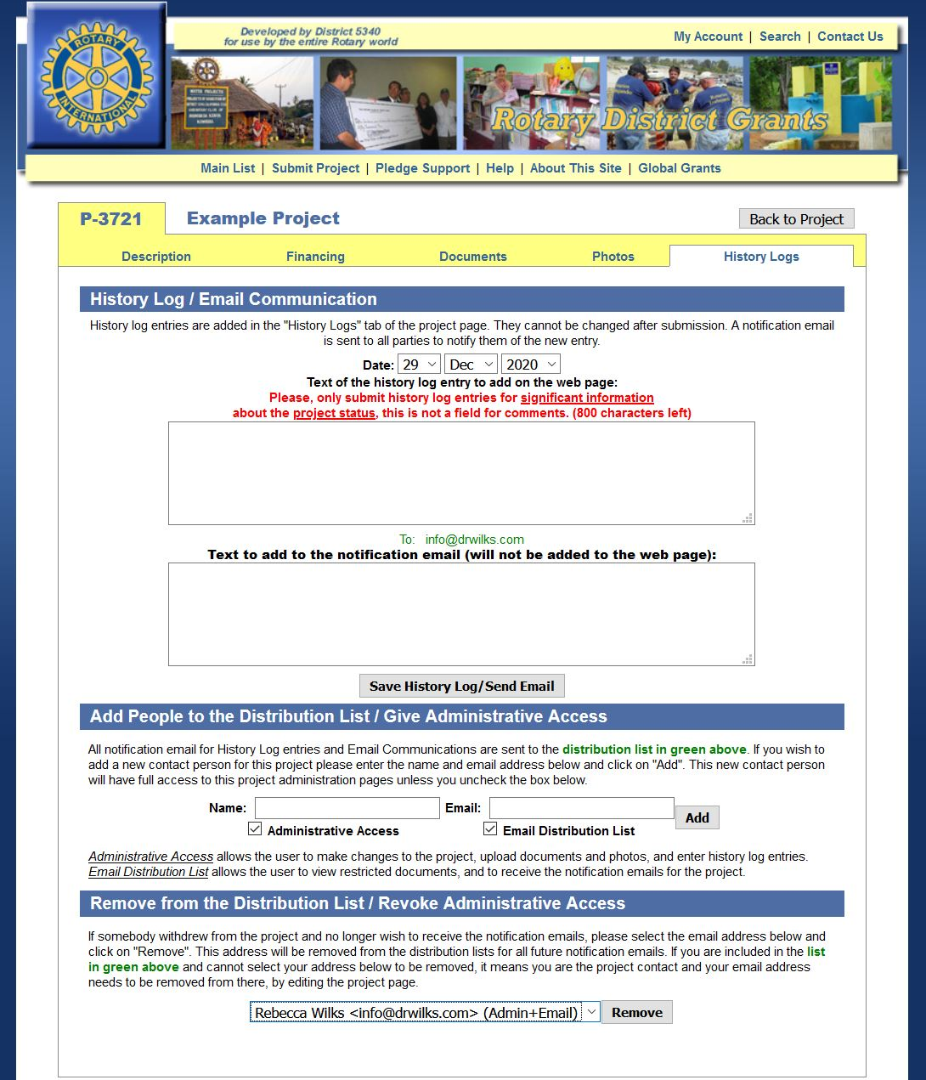

Slide 51
DISTRICT GRANTS; Application
Application is complete when:
Online application is correctly completed and signed
Club is qualified

Slide 52
DISTRICT GRANTS; Application
Second and third applications:
Will be funded if possible
Identify your club’s first priority project in the application.

Slide 53
DISTRICT GRANTS: TIMELINE
Applications due:
    May 31, 2023
The committee meets and submits the “Spending plan” to TRF before:
    June 30, 2023
Money should arrive in
    July 2023
Project final report due:
    April 30, 2024
Notes:
Note that the application process is complete before the relevant Rotary year even begins.

Slide 54
DISTRICT GRANT : Final Report
All projects must be completed and reported by April 30, 2024
Report form is available on the District website
Upload in PDF format to the project page:
  A completed and signed final report form
  Copies of all “paid” receipts
  Project photos (preferred, not required)

Slide 55
DISTRICT GRANT : Troubleshooting
Deadlines
  Application
  Previous reports
Guidelines
Qualification
  MOU
  Giving
  training
Project start and end dates
Pay attention to website emails

Slide 56
The Big Picture

Slide 57
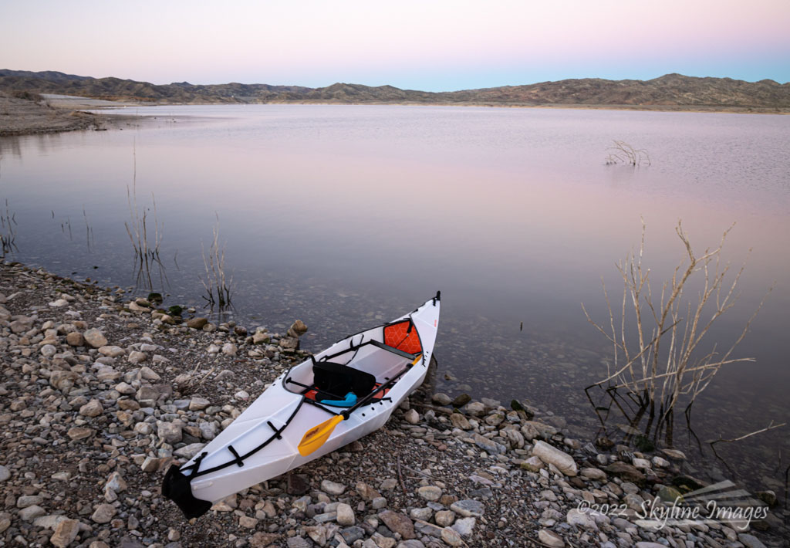
Questions?

Slide 58
Session 3
Global Grants

Slide 59

Global Grants
Fund international projects, scholarships,
and vocational training teams
Host Sponsor Club (project location) and
International Sponsor Club from
another country (primary $ sponsor)
$30,000 minimum total project cost
Must be sustainable with measurable outcomes
Stewardship requirements for clubs
Notes:
This type of grant funds international projects. It requires at least two clubs, each from a separate country. One is host club where the project takes place and the other is the international partner club that generally provides most of the funding.
Clubs and districts may develop their own global grant projects, or they can choose from a list of host clubs who are searching for international partner clubs.
Charlie

Slide 60
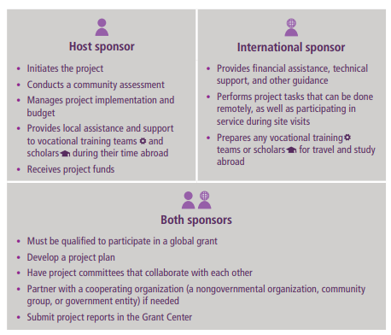

Slide 61

Global Grant projects must align with an Area of Focus:
Notes:
Unlike District Grants which can be broad in scope, Global Grants must align with an Area of Focus.
The Trustees of The Rotary Foundation identified six areas of focus for the grant structure. These areas reflect critical humanitarian issues and needs that Rotarians are addressing worldwide. They align Rotary with other international development efforts and will strategically further the Foundation's mission.
The Trustees have committed to these areas of focus until year 2021. Let’s talk about the need in each area of focus.
Charlie

Slide 62
A primary goal of the Rotary Foundation is to develop projects and programs which are larger in scope and self sustaining.
Clubs and Districts are encouraged to work together on fewer but more impactful projects.
Community Needs Assessment is critical for sustainability.
Clubs and Districts are encouraged to work with other agencies to combine resources. But to receive grant funds, projects must be Rotarian led.
Goals:
Community funding to cover operations and maintenance
Local Capacity development
- Technical skills
- System operations
- Accounting skills
- Leadership skill
Transparency
Notes:
Rotary Foundation Global Grants fund projects and activities that are sustainable and measurable and relate to the goals of the areas of focus. In order to support these goals, global grants provide larger awards for projects and activities with a minimum World Fund award of $15,000, resulting in a total project cost of US$30,000 and above.
Clubs and districts may develop their own global grant projects or they can choose from a menu of packaged global grants that the Foundation is developing in conjunction with its strategic partners.
Since global grants include a World Fund match they are a flexible and economical option for scholarships. In addition, clubs can partner together to develop holistic projects that incorporate humanitarian and educational activities in the same grant, again, as long as it relates to the areas of focus.
Charlie

Slide 63
Community Needs Assessment
(NOT AN OPTION)
Choose a project that is based on the community’s need
1
Assess resources of the community, your clubs and potential partners (local NGOs, Government agencies)
2
Talk to multiple levels of stakeholders in the community
3
Review and complete the Community Needs Assessment form (found on the District and Rotary International web sites.
4
Notes:
Key points
Asking members of the community what they need helps ensure greater buy-in and involvement, which leads to a more sustainable, lasting impact.
Once the needs are identified, your club should consider which can be addressed with the resources and availability of your club and its potential partners, including other Rotary clubs, districts, The Rotary Foundation, or non-Rotarian organizations.
Continue involving the community during the selection of the project and its planning and implementation.
The RI publications Communities in Action and Community Assessment Tools offer information and resources for conducting a community needs assessment.
Has anyone been involved in conducting a needs assessment before? If yes, briefly explain your experience.
George

Slide 64
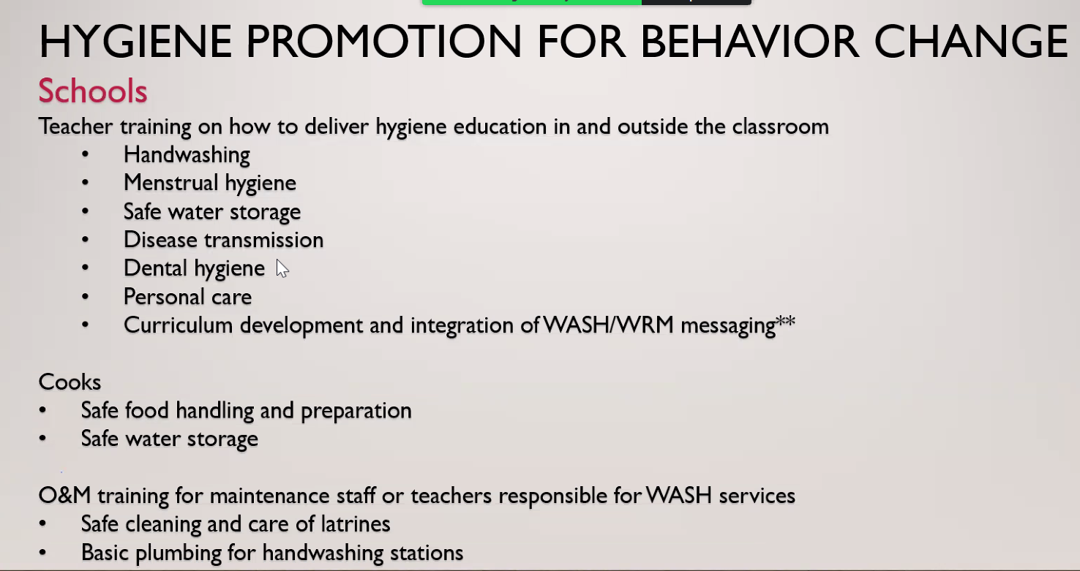
Rotary is focused on Behavior Change
Notes:
Rotary is looking for projects that have a demonstrated plan for not only providing a short term solution to a problem but also working with others to start to change behavior.

Slide 65
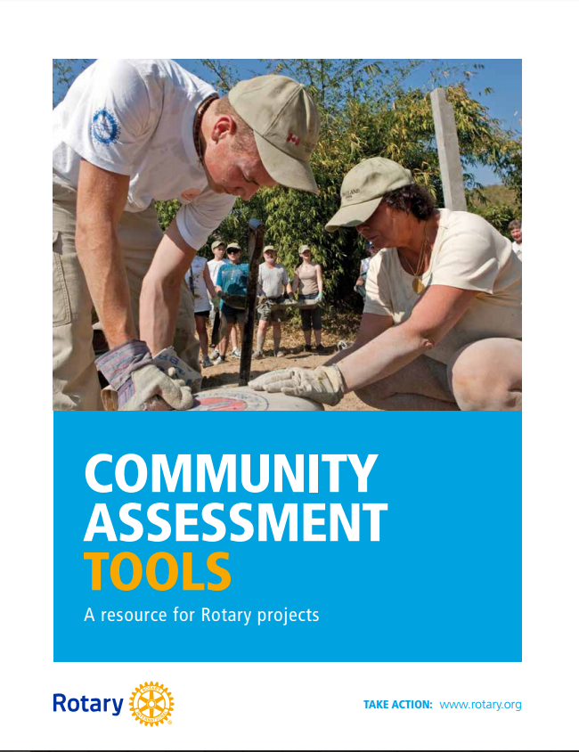
Resource:
Community Assessment Tools manual
Tips for conducting a community assessment
Recommended stakeholders
Methodologies
Notes:
This Rotary publication walks through all the methodologies on the previous slide, as well as provides tips for conducting community assessments as well as recommended stakeholders for each Area of Focus such as local government authorities, school administration, universities, or community health care workers .
This resource is also available on My Rotary, or our District 5495 website.

Slide 66
Project Planning
Form a three-person grant committee from both Host and International Clubs
Assign roles – get people with different skills
Implementation plan (controls budget)
Budget plan
Contingency plan
Document retention plan
Notes:
Key points
Rotarians must manage all projects that receive funding from The Rotary Foundation.
Both the host and international partners must have a committee of three Rotarians to manage the project.
Roles and responsibilities should be assigned to everyone on the committee.
Who would you include on the three-person committee?
Sample responses
Club Rotary Foundation committee members
Club member with project management/grant experience
Club member with financial background
Club member who has experience with partner’s country
Key points
Create a plan for managing funds and implementing the grant.
Develop a budget that includes details and a timeline for the purchase and distribution of goods, construction, training, and any other activities.
Consider your liability for the project, ensure that your club is protected, and have a contingency plan should something go wrong.
Set up a process for retaining documents related to the grant (see club MOU section 4) before funds are received.
George

Slide 67

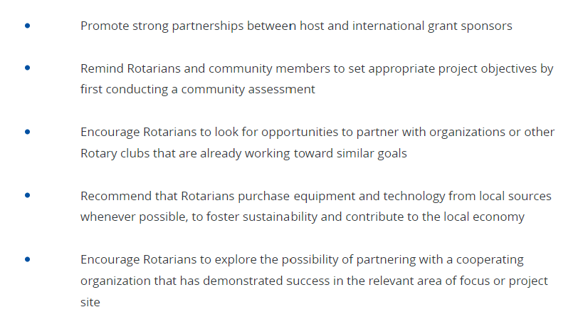
Creating a Budget
Notes:
Key points
A budget should be realistic and comprehensive to ensure adequate funding.
When choosing a supplier, Rotarians should use a competitive bidding process to ensure that they get the highest quality goods at the most reasonable prices.
Clubs should keep records of any bids submitted with grant files for reference (see club MOU section 4).
Clubs must disclose any potential or real conflicts of interest related to the budget (see club MOU section 1C).
George

Slide 68
GLOBAL GRANT FINANCING EXAMPLE
2022-2023 Model
SOURCE OF FUNDS | AMOUNT | DISTRICT MATCH (0%) | TRF MATCH (80% of DDF only) | TOTAL
Clubs / Individual Contributions | $12,000 |  |  | $12,000
District Contributions (DDF) | $10,000 |  | $8,000 | $18,000
TOTAL |  |  |  | $30,000
Notes:
How does the funding work?
Combining a $5000 club check with other clubs, our District and friendly Districts and the TRF World Fund creates a 6:1 multiplier.

Slide 69
Request for DDF
Clubs must submit a Request for DDF Form
DDF is allocation is limited on the basis of available funds.
DDF depends on availability, sponsor contribution, scope of project, and District Governor approval.

Slide 70
Conflicts of Interest
Rotary wants both of the Clubs to disclose conflicts of interest
But the TRF understands the reality of the 3rd world.
In many 3rd world programs the Rotarians are also local business leaders – disclosure is not the same as prohibited.
3 bid for pricing is best practice but not practical in a remote village – just explain why your pricing is favorable – less transport costs, creates jobs and capacity building.

Slide 71
Summary of Successful Global Grant Projects
Meet real community needs identified by community assessment
Need careful planning
Must be sustainable for global projects
Requires proper stewardship of funds
Have measurable outcomes
Notes:
71
Key point
As discussed during the opening plenary session, successful grant projects:
Meet real community needs
Have frequent partner communication
Have an implementation plan with measurable goals and outcomes
Are sustainable projects that continue after grant funds have been expended.
Practice proper stewardship of grant funds
How has your club identified community needs in the past?
George

Slide 72
Part 3.2
Okay Now You are Ready to
Apply for a Global Grant
Notes:
Charlie

Slide 73
Global Grant Process
Online Application through RI website
Involves Rotary clubs in at least two countries: Host Sponsor Club & International Sponsor Club
Minimum budget of US $30,000.
Application can be kept in draft status for 12 months
Notes:
Key points
Rotary clubs (as well as districts) can apply to the Foundation for a global grant.
Global grant requests can be submitted online at any time through Member Access on Rotary.org. It is a two-step process: proposal and application.
To be eligible to receive a global grant, a project or activity must support at least one area of focus and meet at least one of that area’s goals
Be sustainable
Involve Rotary clubs in two pilot districts
Have a minimum budget of US$30,000
The district must confirm that a club is qualified to receive a global grant.
Charlie

Slide 74
Cash Guidelines
Cash contributions come from clubs and/or individual Rotarians
Funds cannot be raised from beneficiaries in exchange for a grant.
Funds cannot come from other grants.
Contributions credited to donor.
Notes:
Key points
Cash contributions for grants must come from Rotarians or be raised by Rotarians in a community fundraiser, unless the funds are already available in the club or district.
Rotarians cannot collect funds from beneficiaries in exchange for receiving the grant.
Contributions cannot come from other Foundation grant projects.
Cash contributions should always be credited to the individuals who gave the funds. Rotarians cannot collect funds from individuals and claim the donation as their own, unless they have received explicit permission from the donors to do so.
How do you raise cash contributions for projects?
How do you cultivate further contributions from donors?
Sample responses
Recognize and thank donors.
Spend funds on their intended purpose.
Report on how grant funds were spent and who benefited.
Charlie

Slide 75
Submit for approval to TRF
Approval can take months – don’t promise fast $$$
Keep ‘contributing’ clubs informed of approval progress
TRF may ask for clarifications or modifications
Upon approval, clubs listed for cash will receive TRF communication to send funds, but project sponsors are ultimately responsible for clubs to honor pledged contributions
Notes:
Key points
Cash contributions for grants must come from Rotarians or be raised by Rotarians in a community fundraiser, unless the funds are already available in the club or district.
Rotarians cannot collect funds from beneficiaries in exchange for receiving the grant.
Contributions cannot come from other Foundation grant projects.
Cash contributions should always be credited to the individuals who gave the funds. Rotarians cannot collect funds from individuals and claim the donation as their own, unless they have received explicit permission from the donors to do so.
How do you raise cash contributions for projects?
How do you cultivate further contributions from donors?
Sample responses
Recognize and thank donors.
Spend funds on their intended purpose.
Report on how grant funds were spent and who benefited.
Charlie

Slide 76
Part 3.3
Implementation
Oversight and Reporting
Notes:
Charlie

Slide 77

Financial Management Plan as required in M.O.U.
Separate bank account for Global Grant funds (if allowed)
Controls on Distribution of funds – 2 signatures
Use checks/bank cards to track funds. Copy cash transaction receipts with cell phone.
Detailed ledger (sent with reports)
Include local laws
Notes:
Key points
Your club should have a club-controlled bank account used only for grant funds. This will help with keeping accurate financial records. Have a plan in place to transfer custody of the club’s account in case a signatory is no longer able to perform their duties.
Once your club receives grant funds, it is important to have a plan for distributing and tracking funds. For example, if you have a scholar, the plan should outline when and how your club will distribute the funds to the scholar.
Expenditures should be made by a traceable method, check, or bank card.
Keep a ledger with transaction details.
Laws in some countries and regions may be more stringent than Foundation requirements. Know your local laws and ensure that they are followed. When local laws are less stringent than Foundation requirements, be sure to adhere to Foundation requirements.
What are the benefits of a financial management plan?
Who is responsible for your club’s financial management plan?
What are some of the local laws that your club needs to follow?
Charlie

Slide 78
District Resource:
Financial Management Plan Template
Clubs in District 5495 are free to use or adapt this document to make your own Club’s Financial Management Plan. Your club’s plan needs to be consistent with the Rotary Foundation Club Memorandum of Understanding, Grant Terms and Conditions, and the Grant Management Manual.
Ask the DRFC for this template!

Slide 79

Record Keeping: Document Retention
Provide access to records for all members
Retain for a minimum of five years
Make copies
Scan and store on the cloud (ClubRunner, DropBox, Google Drive, etc.).
Notes:
Key points
Documents should be accessible to everyone in the club. For example:
Keeping documents in a binder or a file system
Scanning documents and saving them electronically to a shared network
Documents must be retained for a minimum of five years or longer if local law requires.
Copies of all documents should be kept in a separate location that is accessible to everyone.
What is your club’s system for document retention?
What types of documents need to be retained?
Sample responses
Bank statements
Receipts of US$75 or more
Inventory tracking for equipment or other assets purchased, produced, or distributed through the grant
Grant applications, reports, and agreements
Communication between grant partners
Charlie

Slide 80
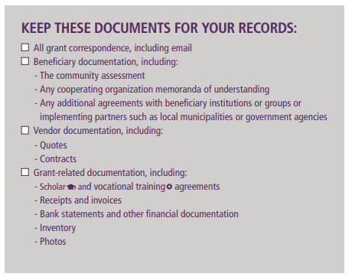
Types of Documents to Keep
Notes:
Key points
Documents should be accessible to everyone in the club. For example:
Keeping documents in a binder or a file system
Scanning documents and saving them electronically to a shared network
Documents must be retained for a minimum of five years or longer if local law requires.
Copies of all documents should be kept in a separate location that is accessible to everyone.
What is your club’s system for document retention?
What types of documents need to be retained?
Sample responses
Bank statements
Receipts of US$75 or more
Inventory tracking for equipment or other assets purchased, produced, or distributed through the grant
Grant applications, reports, and agreements
Communication between grant partners
Charlie

Slide 81
Global Grant Reports to TRF
Progress reports
  12 months following approval
  Every 12 months through the life of the grant
  Final report within 2 months of completion
Notes:
Key points
Progress reports must be submitted via Member Access at Rotary.org within 12 months of receiving the first global grant payment and every 12 months thereafter.
The final report must be submitted via Member Access within two months of completing the project or activity.
Unused grant funds may be used for additional, eligible, and approved expenses. Any unused funds returned to The Rotary Foundation will be credited to the World Fund.
What kind of information should be included in global grant reports?
George

Slide 82
Global Grant Report Content
How partners were involved
Activity to date
Evaluation of project goals
How area of focus goals were met
How funds were spent
Number of beneficiaries and how they benefited
Notes:
Key point
Progress and final reports must include the following information:
How both partners were involved in the grant
Information on the type of activity (humanitarian project, scholar, vocational training team)
Evaluation of project goals
How the goals of the area(s) of focus were met
How funds were spent
Number of beneficiaries and how they benefited
George

Slide 83
Part 3.4
Resources

Slide 84

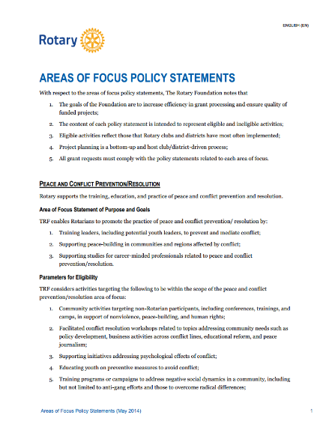

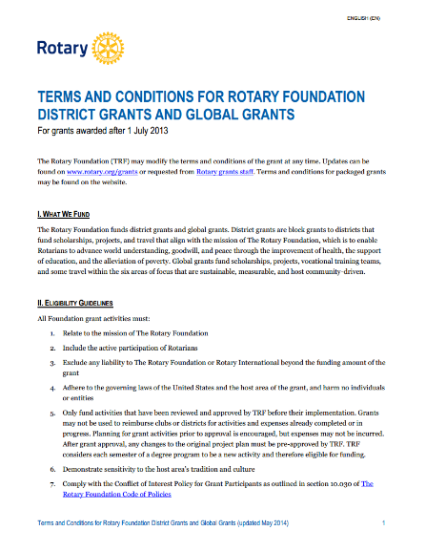

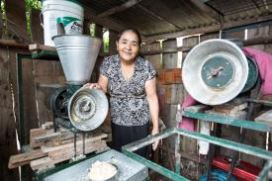
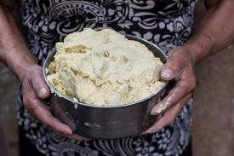
Global Grant Resources
A Guide to Global Grants
Areas of Focus Policy Statements
Rotary’s Areas of Focus
Terms and Conditions for Rotary Foundation District Grants and Global Grants
Notes:
Also, check out these global grant resources when you are considering your next project. You can find all documents at rotary.org.
Questions?

Slide 85
03/03/2022
2022 Foundation Homepage | District 5495
From the DRFC
DRFC Team Roster and Contact
How to make TRF the Charity of Choice in your club
Speakers for your club
Connect Through Giving Campaign
Quick Resources Rotary Foundation Reference Guide
Recognition Opportunities
Foundation Contribution Form
The Rotary Foundation (Website)
DONATE HERE link
Planned Giving link
Education
Nov. 16
Grants: Requirements, Qualifications and more…
Clubs qualified for 2020-21 grants
Club Qualification Requirements for 2020-21
Grant Management Seminar
Terms and Conditions
Memorandum of Understanding and Addendum
District Grants
District Grant Guidelines for 2019-20
District Grant Application Website
District Grant Final Report Form
District Grant projects approved in 2019-20
Global Grants Guide to Global Grants
Request for DDF Form
Global Grant Application Template
Global Grant Calculator
Community Assessment Tools
Community Assessment Form
TRF Website link
Global Grant Project List
International Projects and Opportunities Mexican American Friendship Conference Results
Navajo Global Grant Water Project
Peace Building Resources
Disaster Response Grants
Polio
End Polio

Slide 86
District 5495 Website
www.rotary5495.org
gdalegray@gmail.com
Global Grants Chair
Grantologist
TRF Cadre Member

Slide 87
Questions?

