Slide 1
WHY I AM A ROTARIAN
Ali Callahan
District Conference June 2019

Slide 2
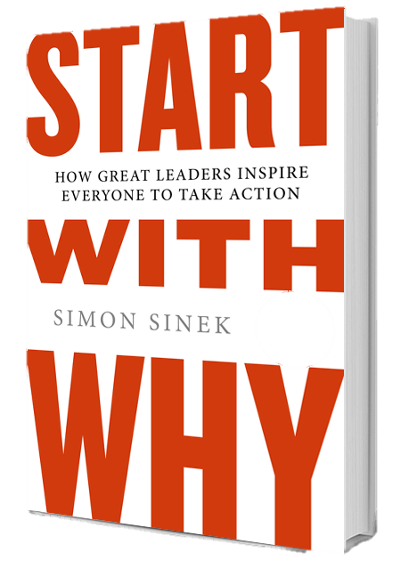
Start With Why
By Simon Sinek

Slide 3
The Golden Circle
WHY
HOW
WHAT

Slide 4


Slide 5
Gather Your Stories
Make them as specific as possible
Strive for at least 3
Think about the details, feelings, and conversations
What are the lessons you’ve learned?
What moments have just stuck with you?

Slide 6
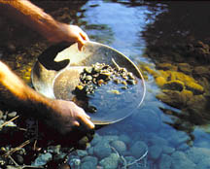
Identify Themes
“As you pan for your stories and share them, themes will start to emerge…one or two of those nuggets will seem to shine brighter than all the others.”
- Find Your Why by Simon Sinek

Slide 7
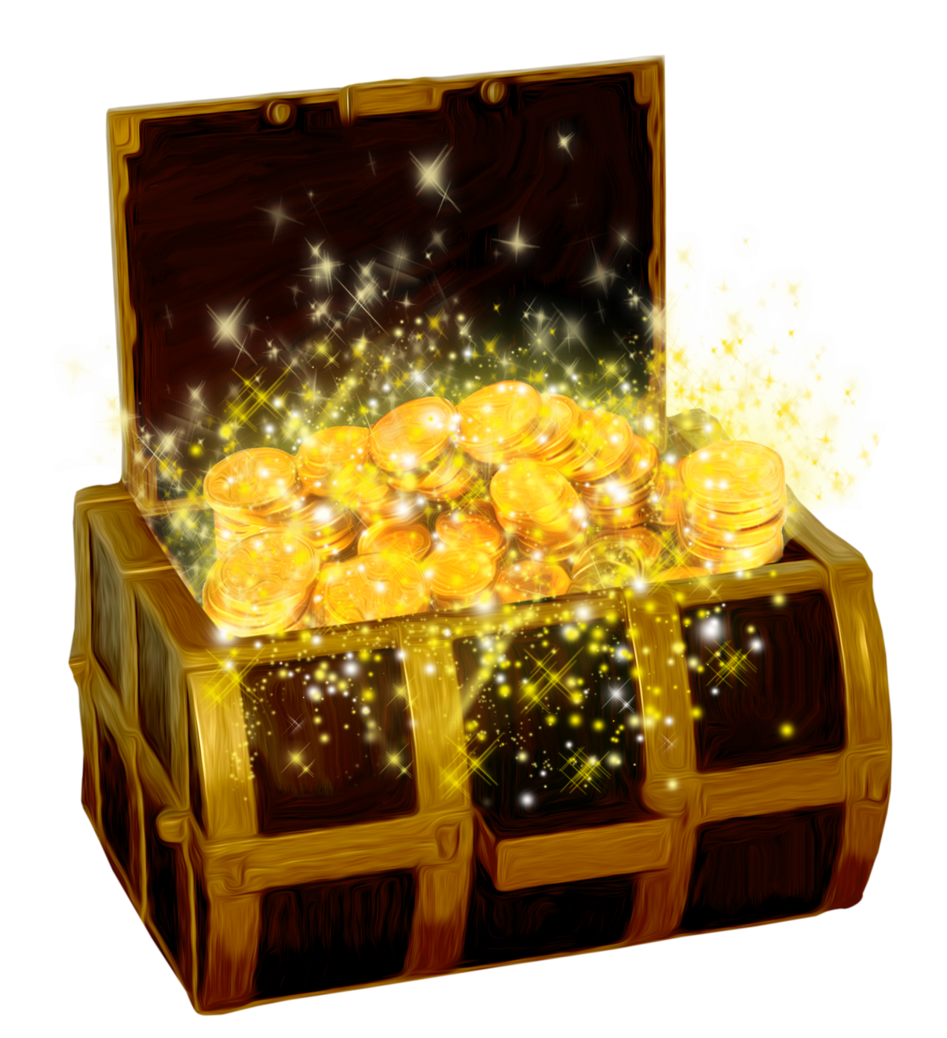
Your WHY Statement
TO ______________ SO THAT ___________________

Slide 8
Your WHY Statement
impact
TO ______________ SO THAT ___________________
contribution

Slide 9
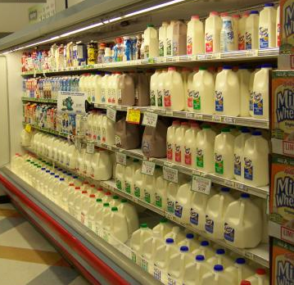

Slide 10
“I Want To Give Back”
 | Rotary | Make A Wish | Arizona Helping Hands
Am I passionate about this?
Volunteer Opportunities
A Chance to Make a Difference
Flexible

Slide 11
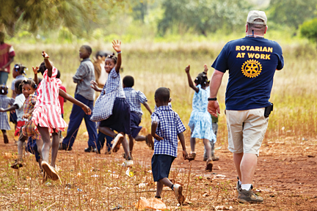
Help Others
FIND THEIR WHY

Slide 12





Rotary In Action
Fellowship | Service | Fundraising | District Events | Youth
I will personally greet every member of my club each week
I will share what the foundation is with 5 people
I will offer to carpool with someone to the conference
I will ask someone to join me at my next service project
I will coordinate to have a youth exchange speaker
Invite Jon out to coffee and get to know him
I will invite someone to the next fundraising event I attend
I will personally invite 3 people to RLI
Ask someone new to be part of my district committee
I will ask someone to attend an interact meeting with me

Slide 13
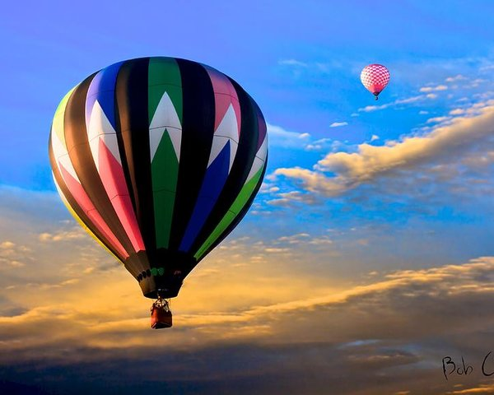
THANK YOU!
“To spread love and kindness to others, so that through compassion, we can make the world a better place.”

