Slide 1

Club Engagement – Best Strategies That Are Happening Now
Ali Rodriguez

Slide 2
Today’s Agenda:
Membership Leads
Club Communication
Club Branding
Planning Resources

Slide 3
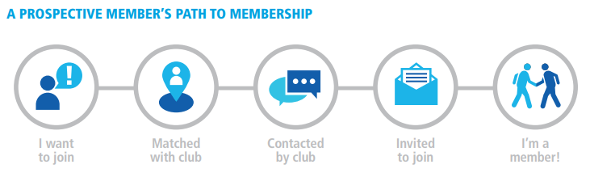
District membership leads

Slide 4
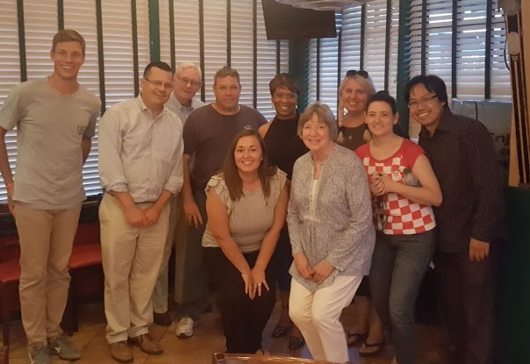
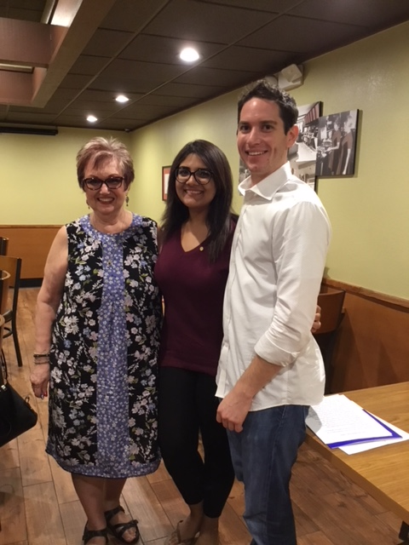
District membership leads

Slide 5
Membership leads- one member’s journey
3/28/18
Received Lead
This lead was assigned twice due to no progress made on communication
8/22/18
Club Visit
Communication continued with invites to all club events
12/12/18
New Member!
Communication continued during the summer, a notification was sent to the club prior to visit
Celebration of a new Rotarian!
4/25/18
Assigned to Club
11/28/18
Submitted Application

Slide 6
Club communication- best practices
Clubrunner
Newsletter
Club Website
Social Media
Emails
Phone Calls
Create a “Prospective Member” email distribution to easily add them to club communication and events
Plan meetings and events in advance
Send post event emails with photos
Ensure all social media sites are up to date!
Involve your entire club in welcoming new members
Ensure your website matches your club culture
Send a monthly or quarterly newsletter
Are you inviting people to visit your club?

Slide 7

What strategies do you use for effective communication in your club?
Round table discussion

Slide 8
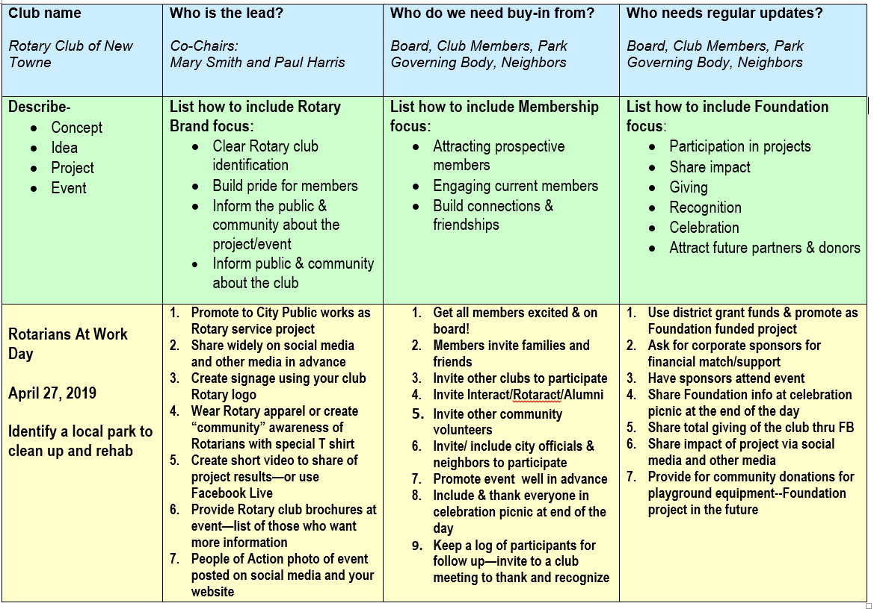

Slide 9
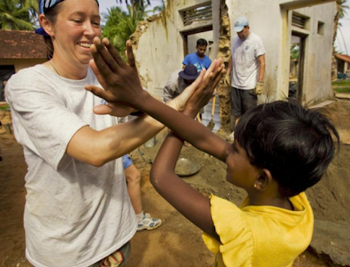
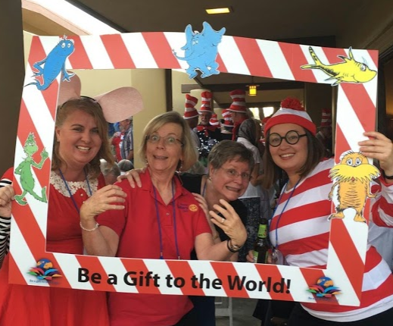
Club engagement
Prospective Members are looking for opportunities that are:
Flexible
Project focused
Family friendly
Diverse

Slide 10
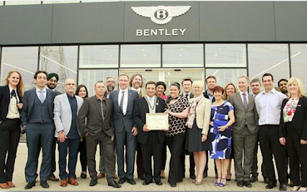
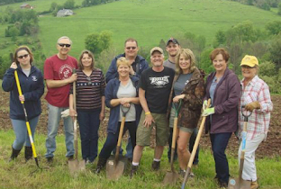

Alternate Club structures
Traditional
Flexible Format
Satellite Clubs
E-Clubs
Rotaract Clubs
Shared Vision and Values
Passport Clubs

Slide 11
How do you keep your club engaged?
Round table discussion
How do you welcome new members?

Slide 12
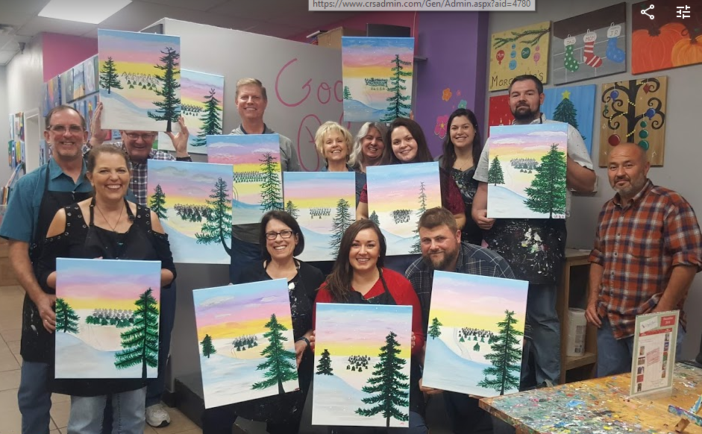
Thank you!!
Notes:
My favorite thing about Rotary….

