Slide 1

Generations of Rotary- Creating a Membership Plan That Speaks to All Ages
Ali Rodriguez

Slide 2
Today’s Agenda:
Generations Of Rotary
Creating a Plan That Speaks to all Generations
Club Engagement
Alternate Club Structures
Membership Leads

Slide 3
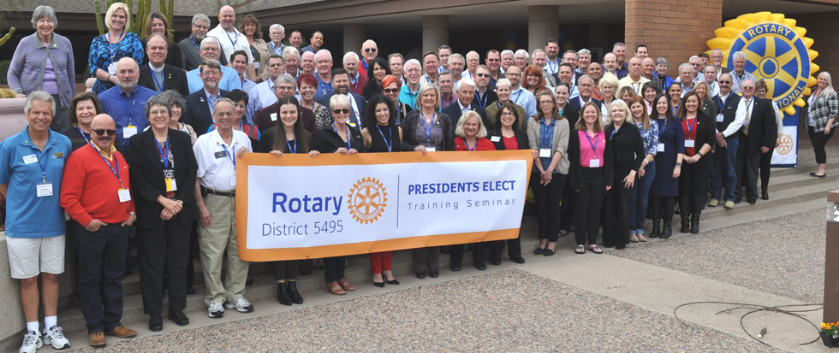
Generations of Rotary

Slide 4
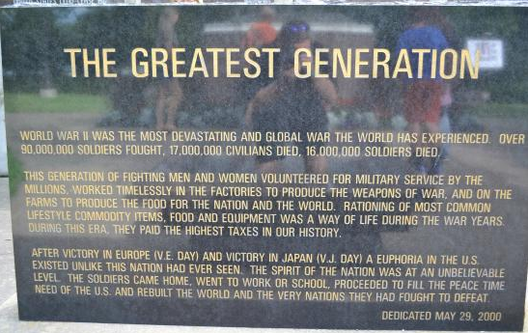
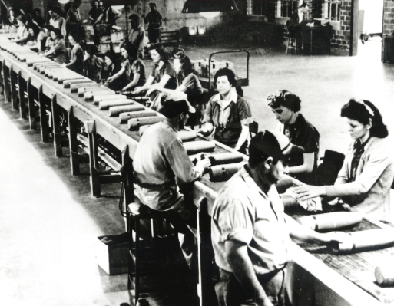
GI Generation

Slide 5
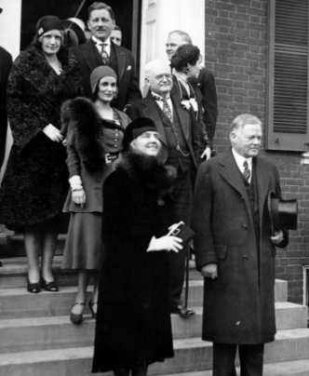
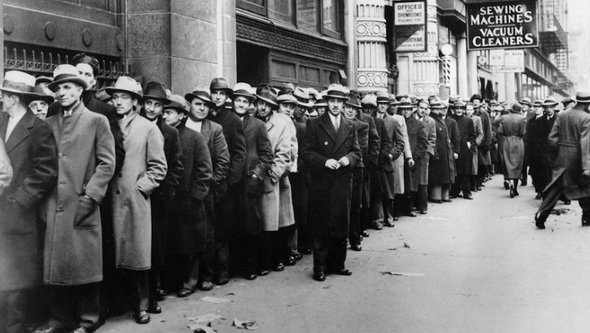
The Silent Generation

Slide 6
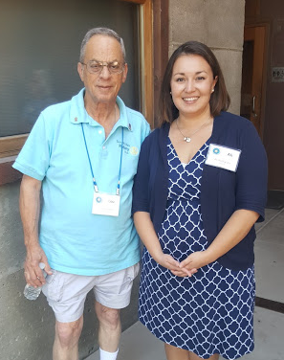
Ideas for this generation:
Create ways where they can share their knowledge
Recognize!
Learning Opportunities

Slide 7


Baby Boomers

Slide 8


Ideas for this generation:
Social Media
Fundraising!
What’s in it for me?

Slide 9
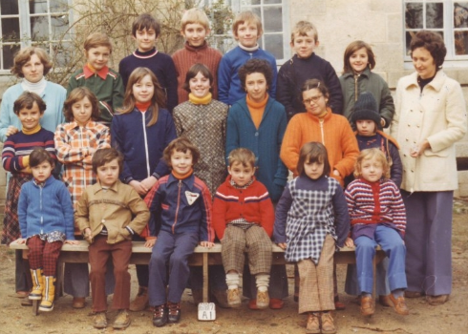
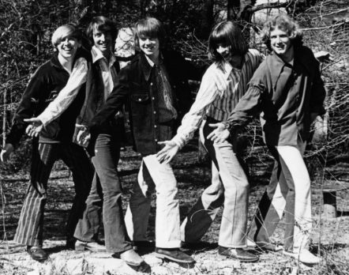
Generation X

Slide 10
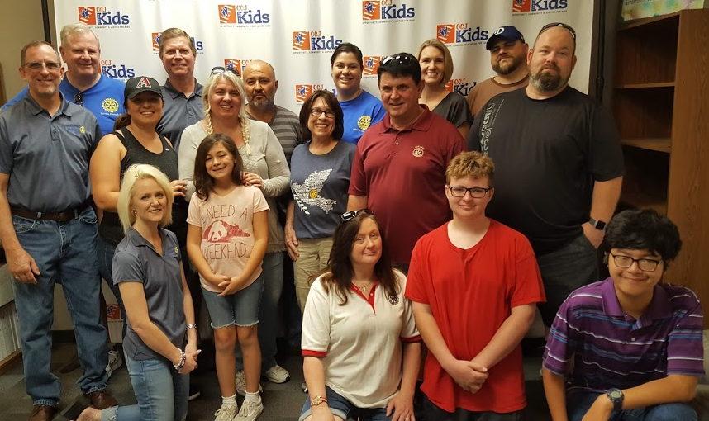
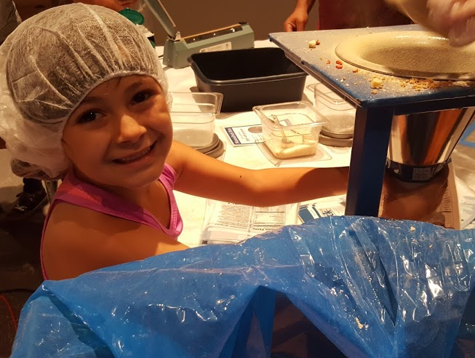
Ideas for this generation:
Adjust your elevator speech
Be authentic
Plan family oriented events and activities
Focus on club engagement

Slide 11


Generation Y/Millennium

Slide 12
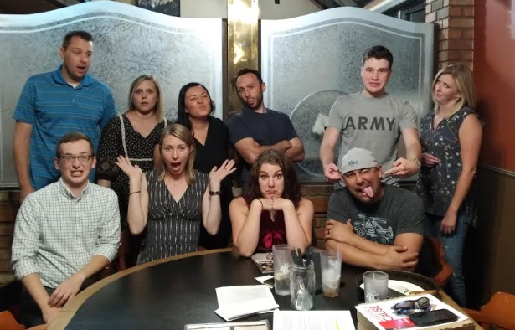
Ideas for this generation:
Diversity
Sell on experiences
Make it meaningful

Slide 13
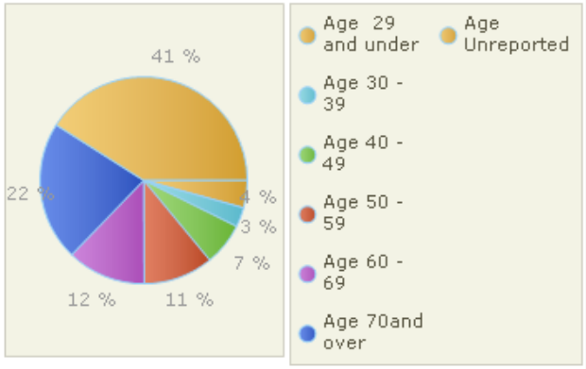
Creating a Plan That Speaks to All Generations
Where is your club now?
What are your goals?
What is ONE change that you can make now?

Slide 14
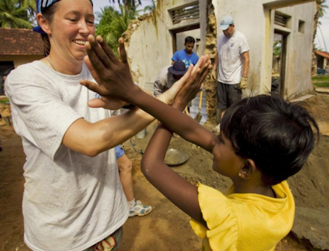
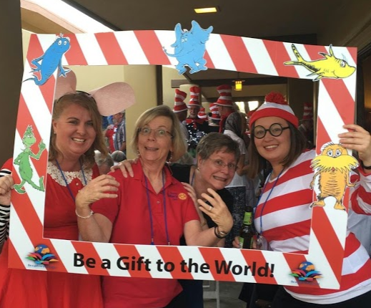
Club engagement
Prospective Members are looking for opportunities that are:
Flexible
Project focused
Family friendly
Diverse

Slide 15
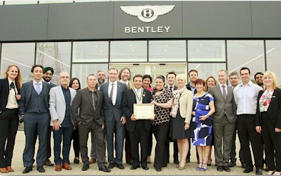
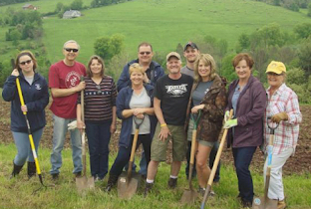

Alternate Club structures
Traditional
Flexible Format
Satellite Clubs
E-Clubs
Rotaract Clubs
Shared Vision and Values
Passport Clubs

Slide 16
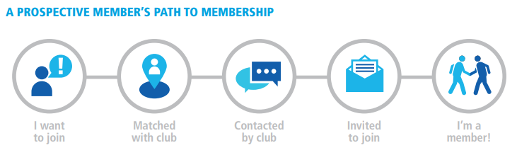
District membership leads

Slide 17
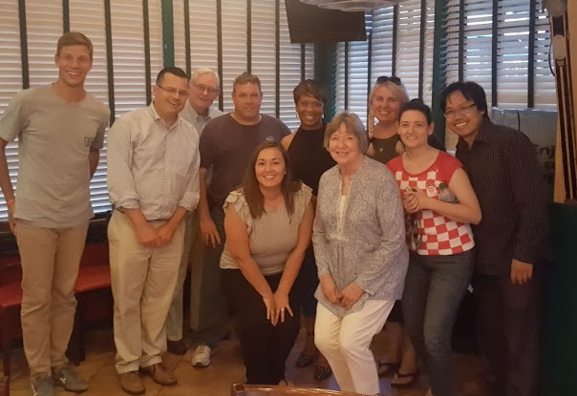
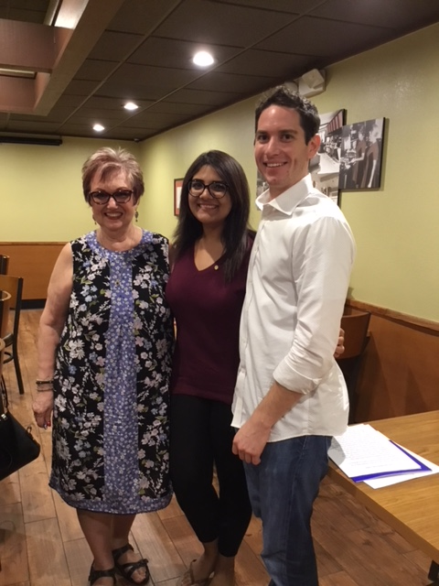
District membership leads

Slide 18
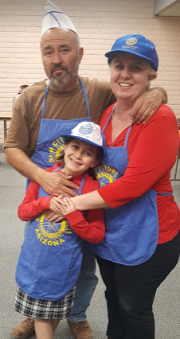
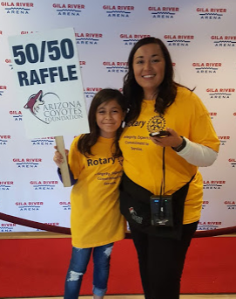
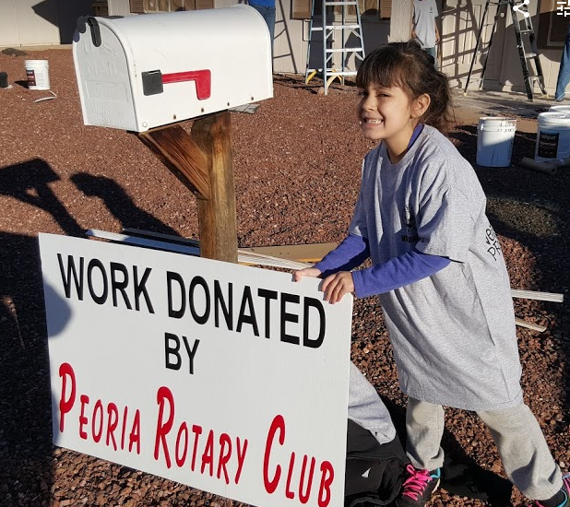
Thank you!!
Notes:
My favorite thing about Rotary….

